Slide 1
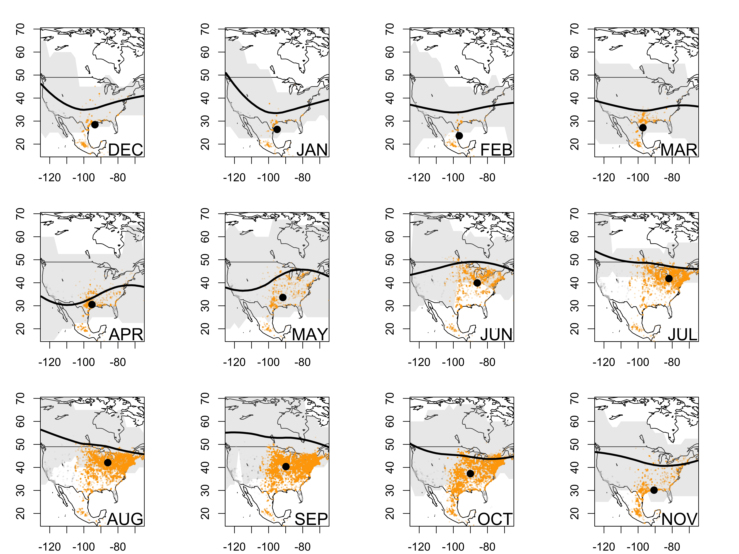
Fig. 1

Slide 2
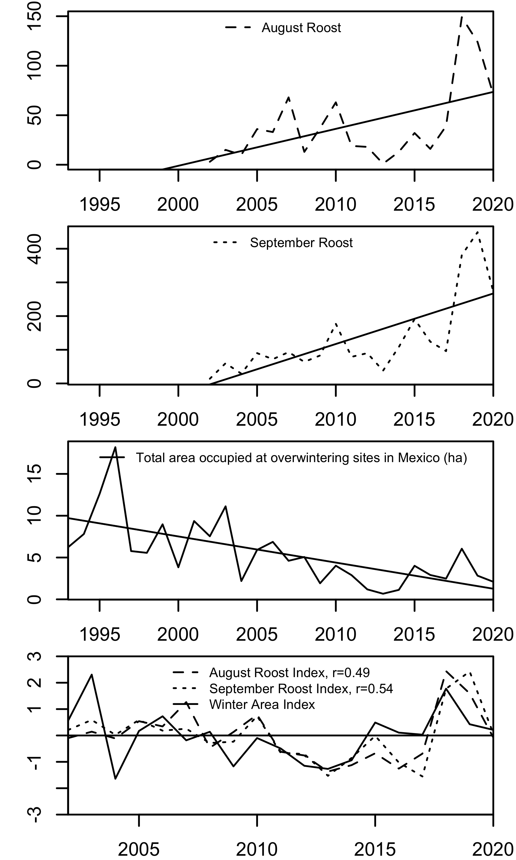
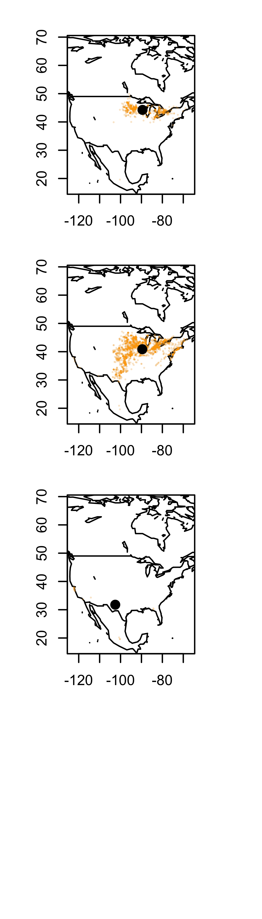
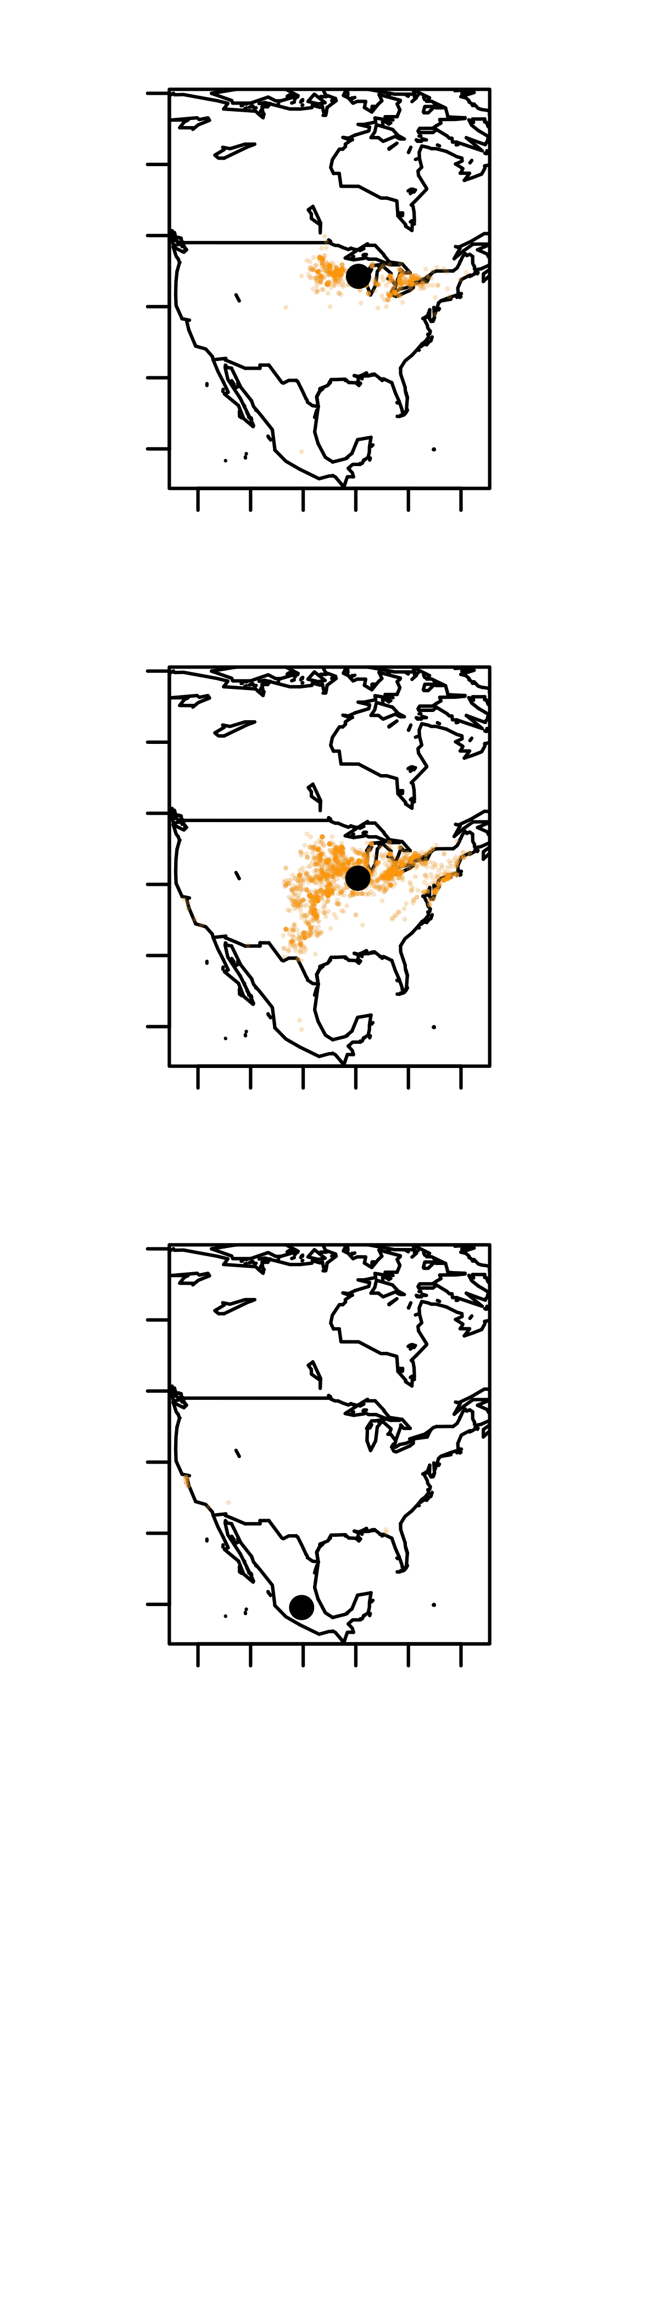
Fig. 2

Slide 3
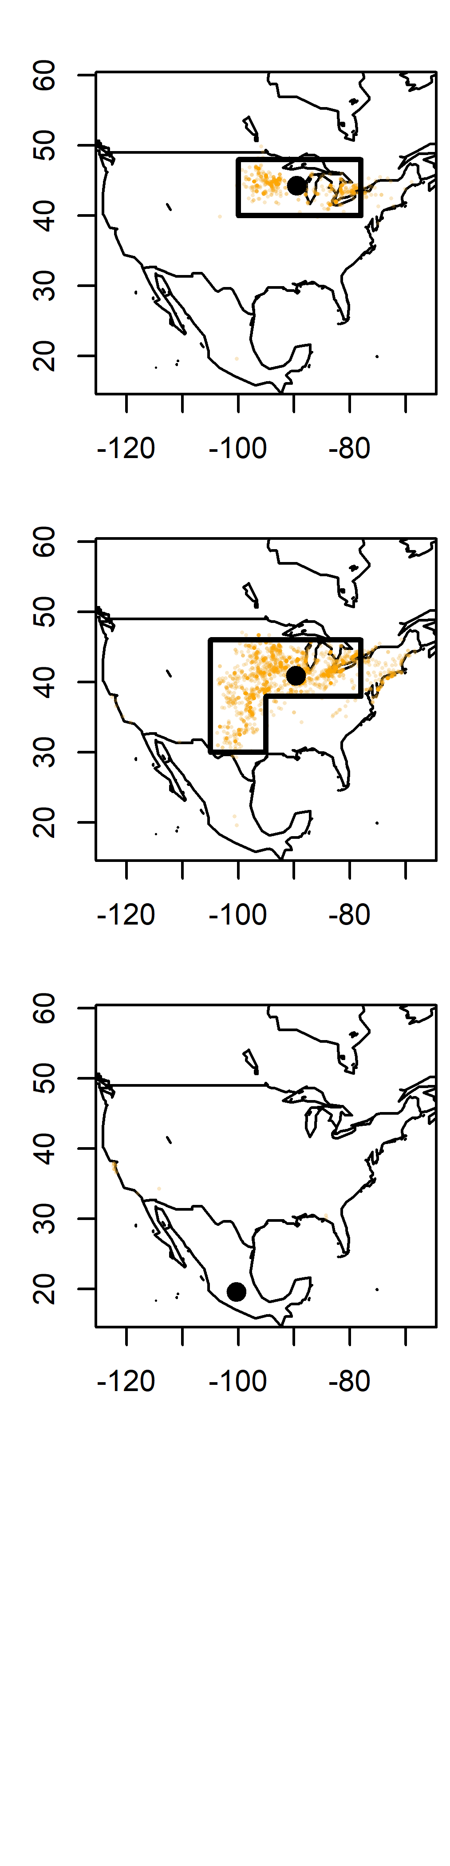
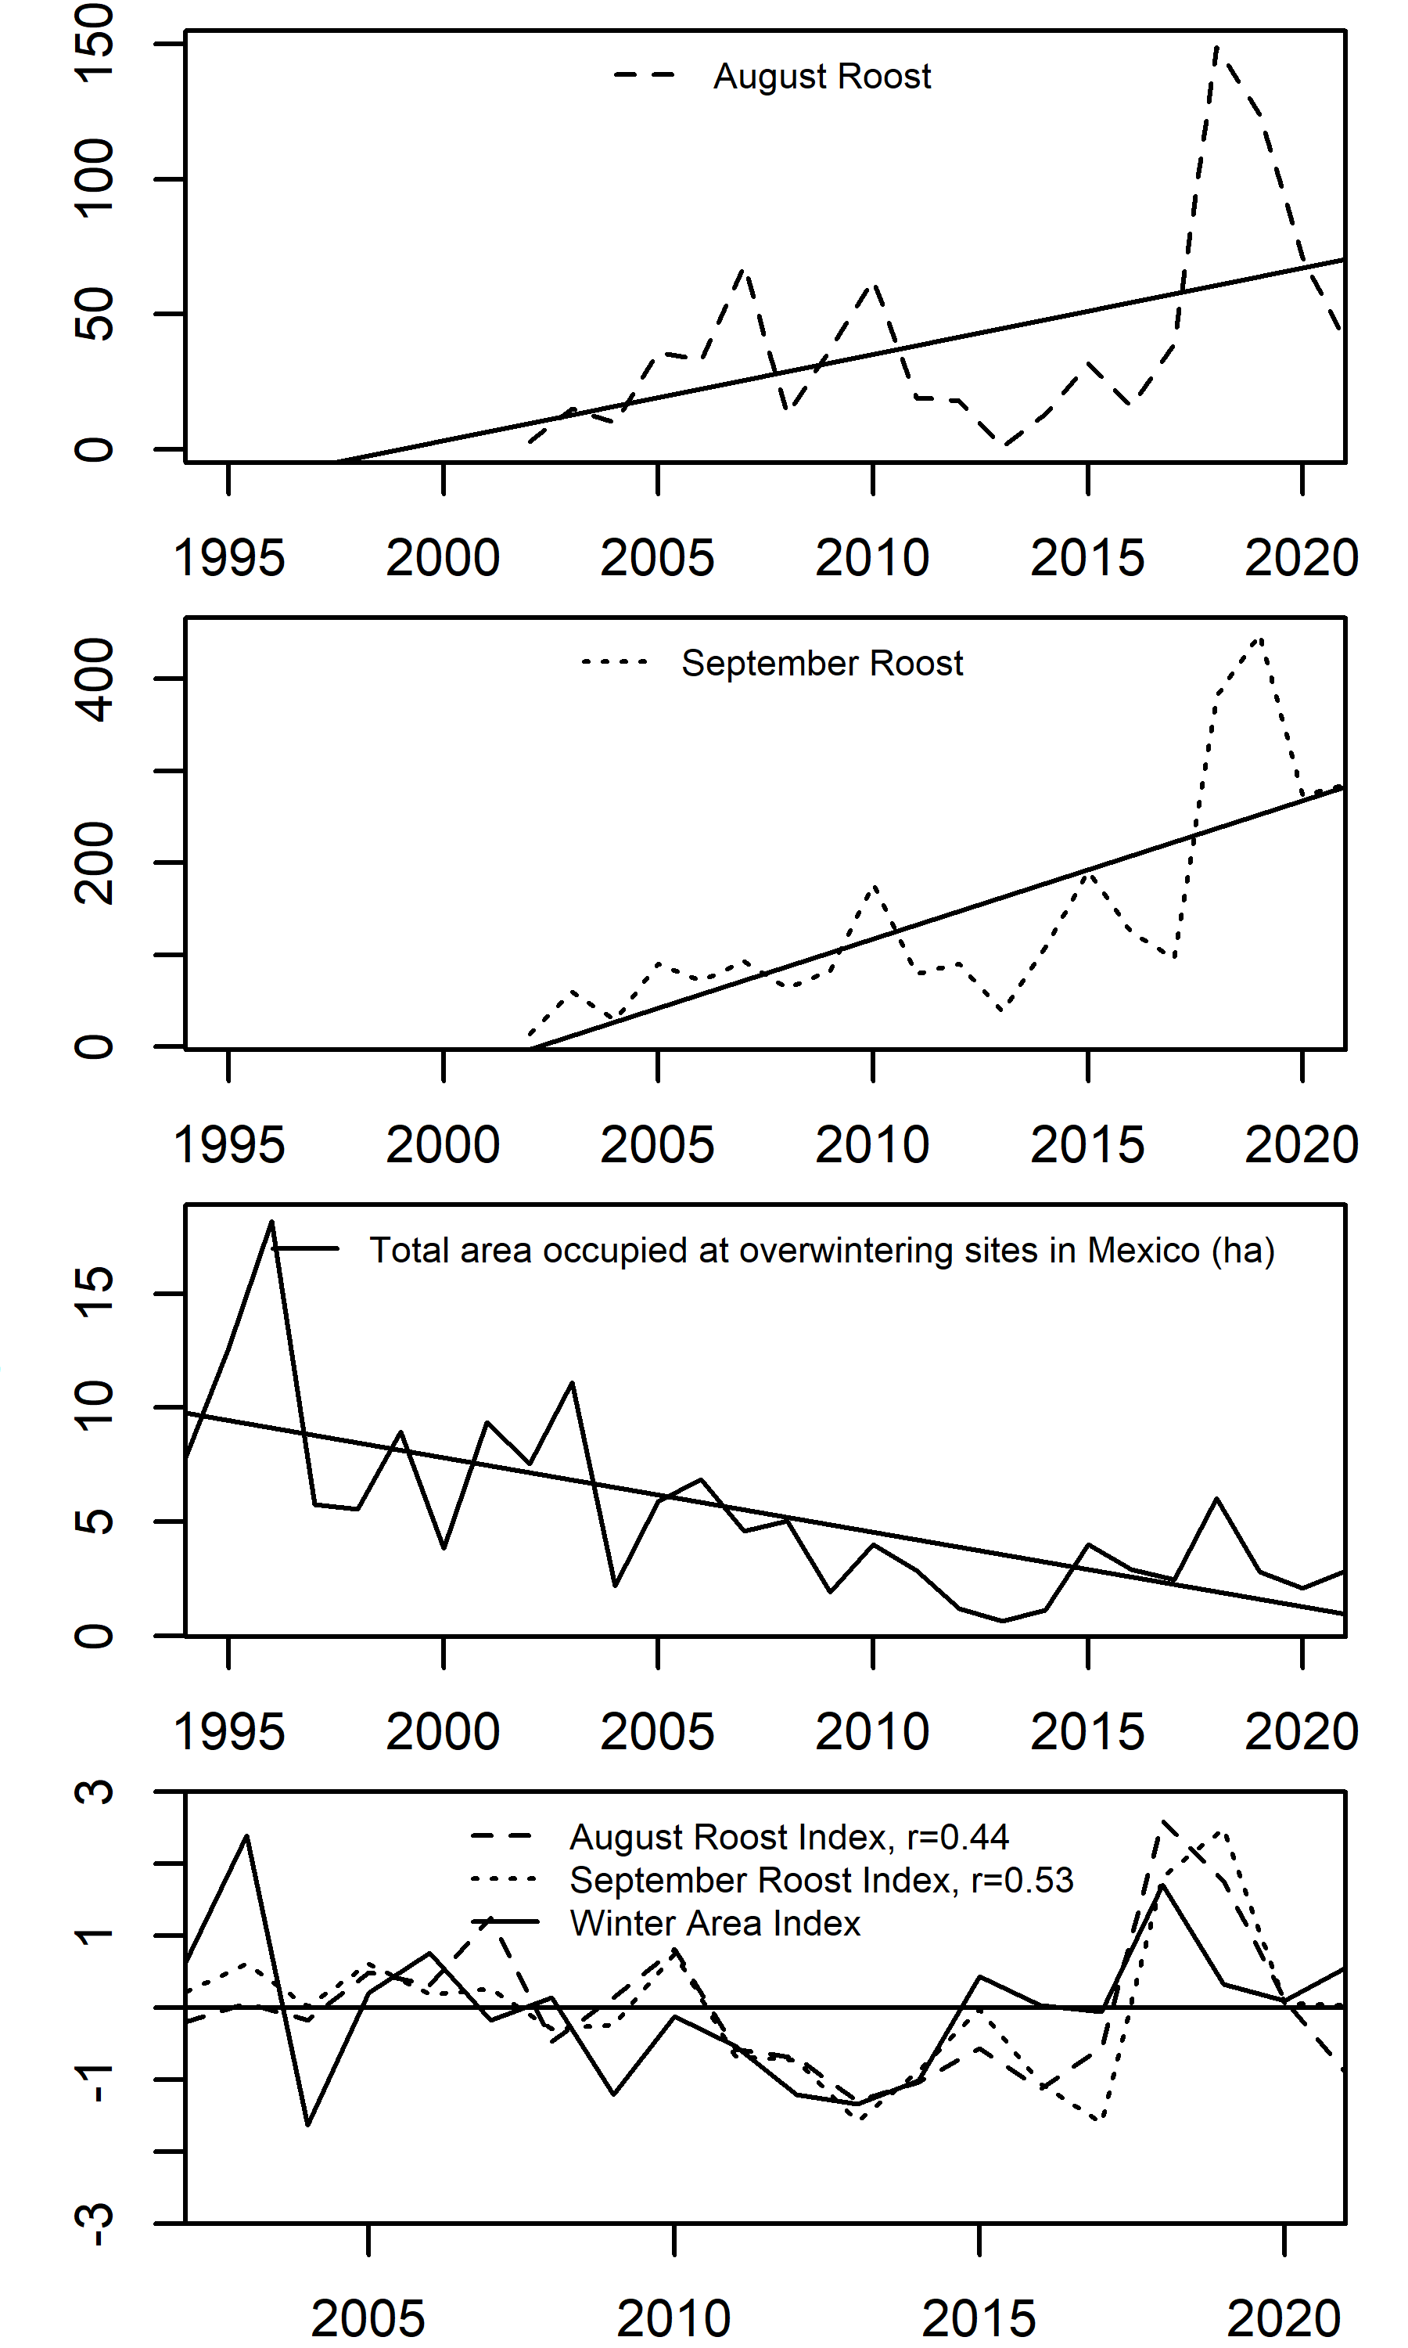
A
B
C
D

Slide 4
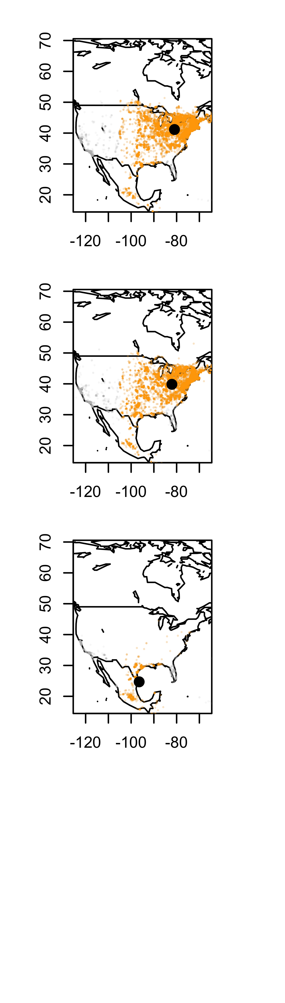
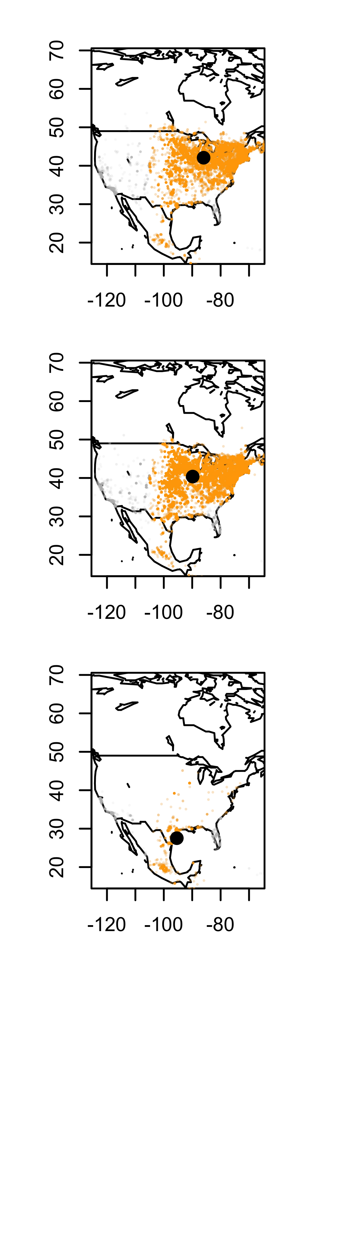
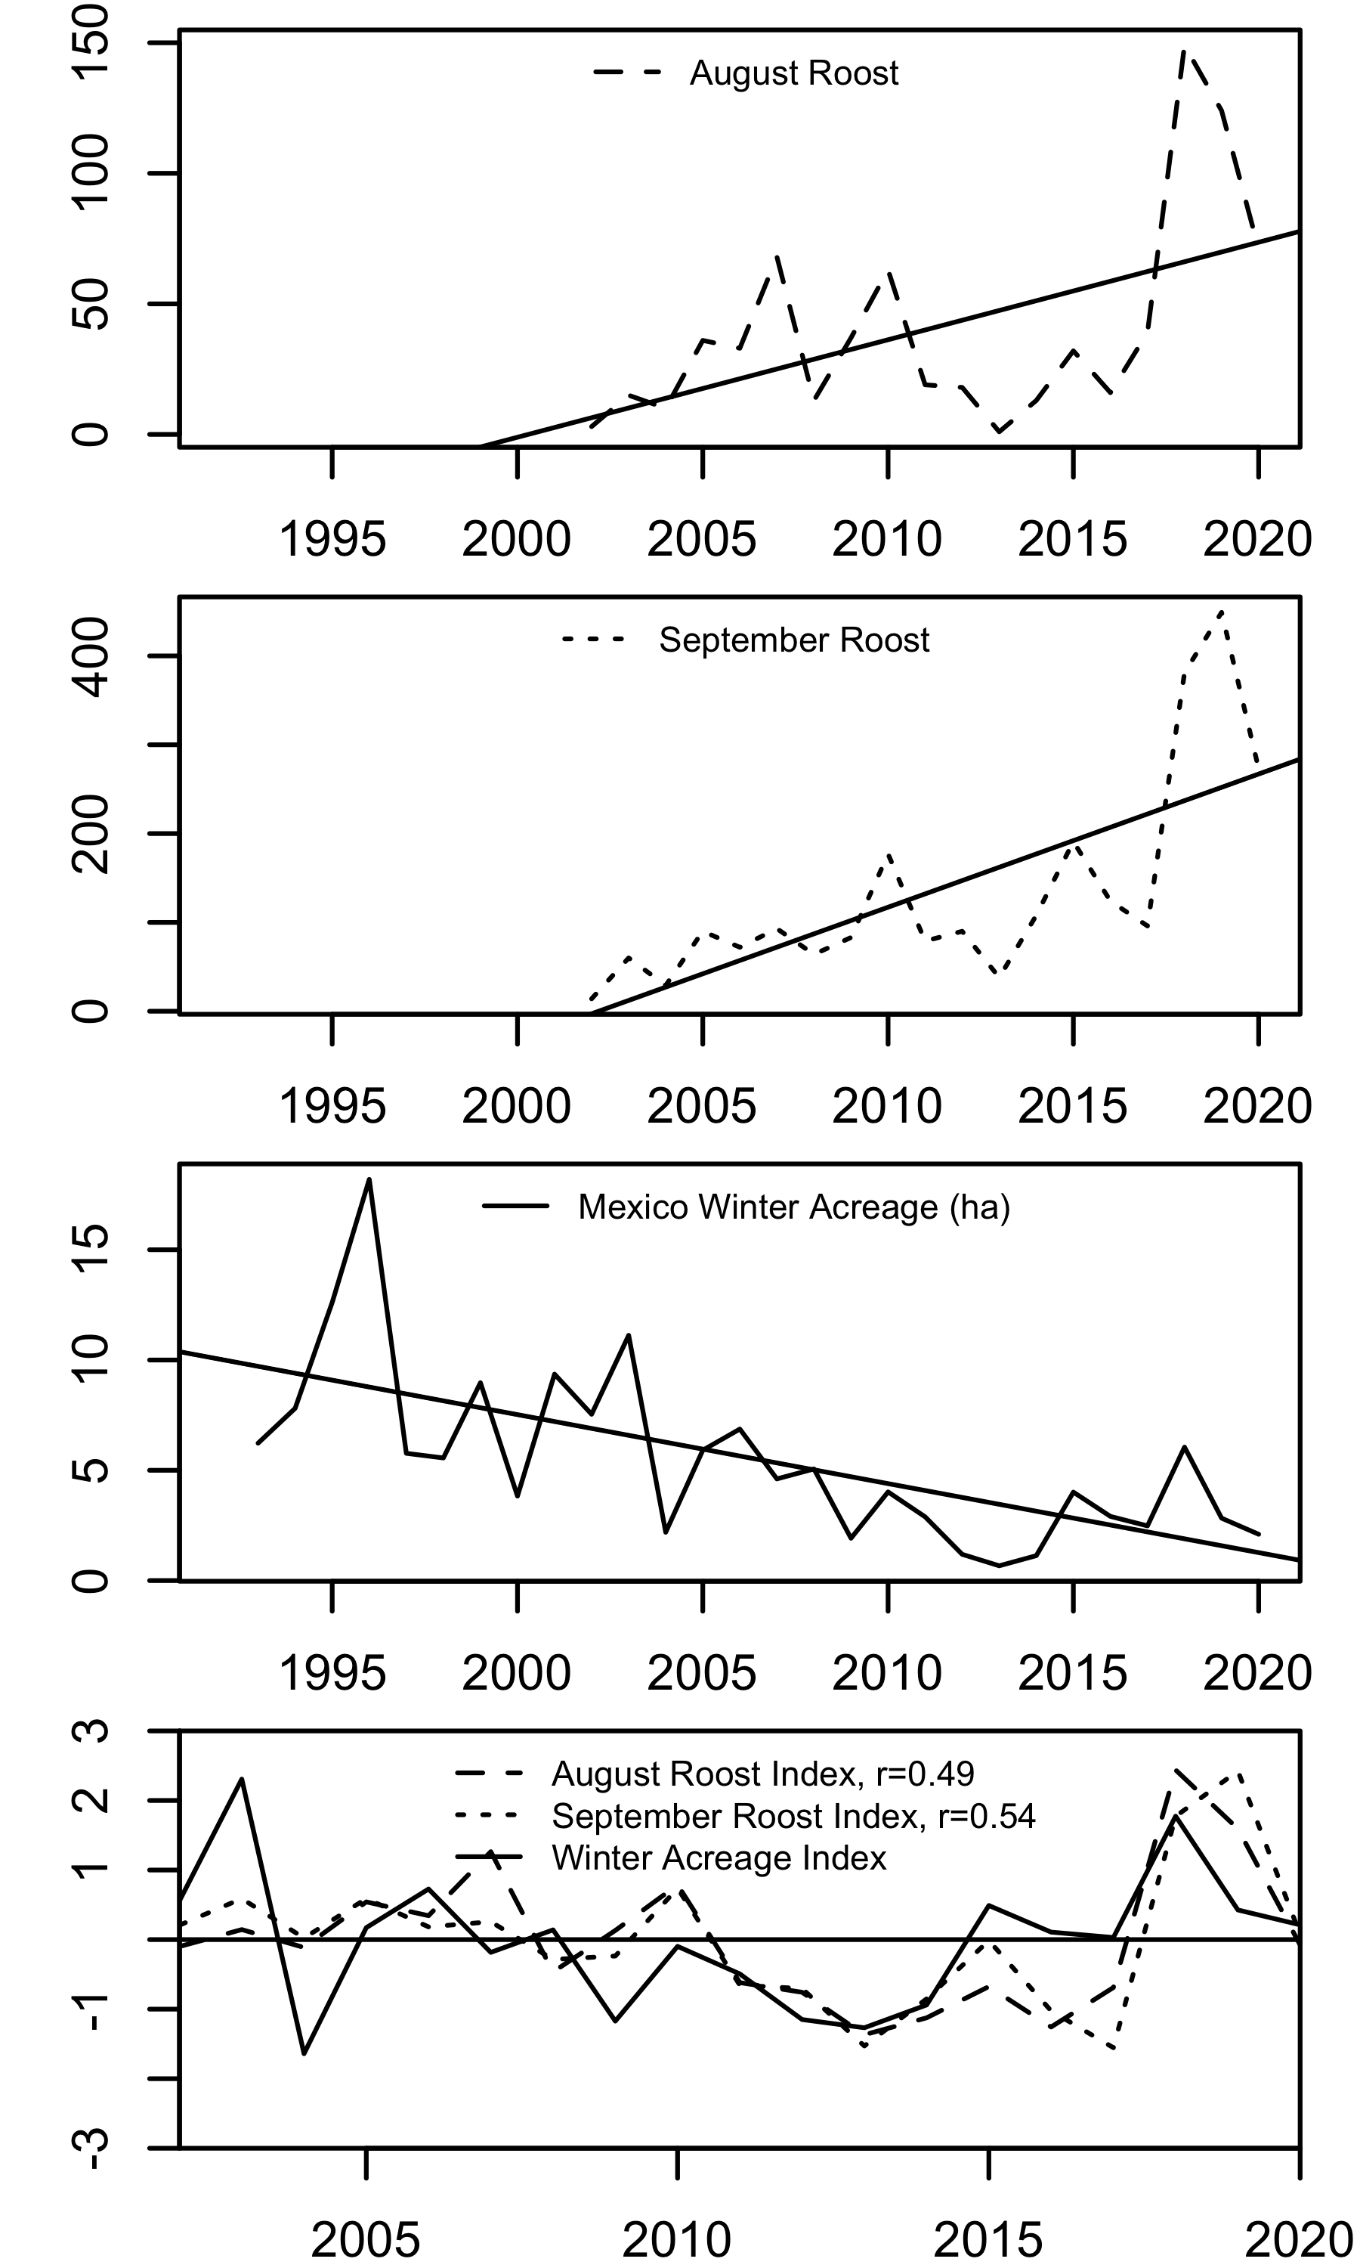
There is high interannual variability in monarch observations throughout the eastern fall migration. Roosting indices and overwintering acreage. A) Map of where monarchs are in August and September and Winter (December). All monarchs and Roosting monarchs B) Time series of August Roost Index and September Roost Index are correlated (r = 0.89); August Roost Index and Winter Acreage Index are correlated (r = 0.49) and September Roost Index and Winter Acreage Index are correlated (r = 0.54)
Fig. 1
A)
B)
GBIF https://doi.org/10.15468/dl.r9g884
2002-2020
GBIF https://doi.org/10.15468/dl.r9g884
1994-2020
Journey North
Fall Roost Data
2002-2020

Slide 5
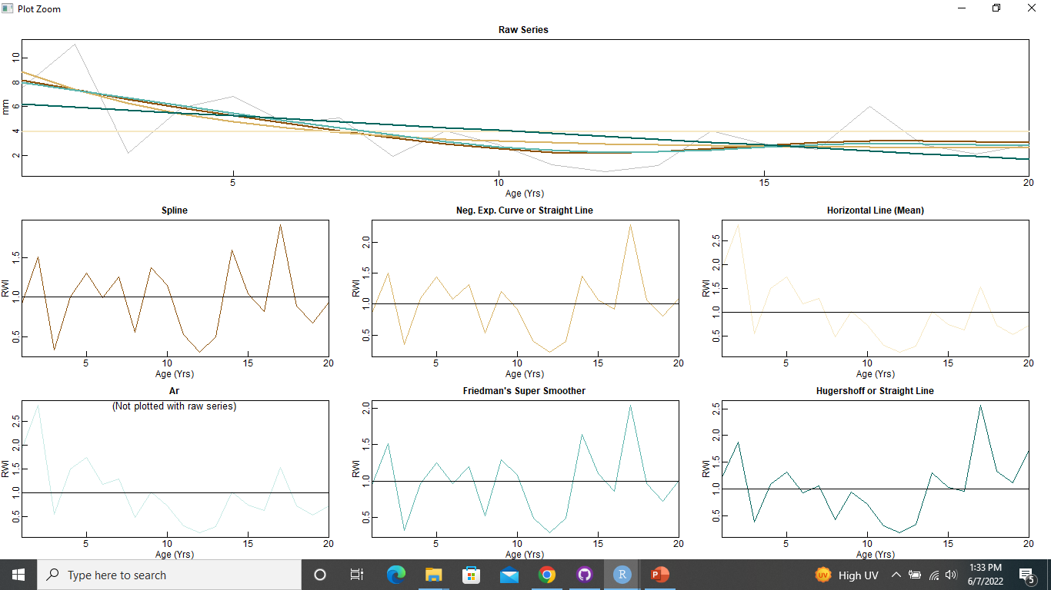
2002-2021 Mexico

Slide 6
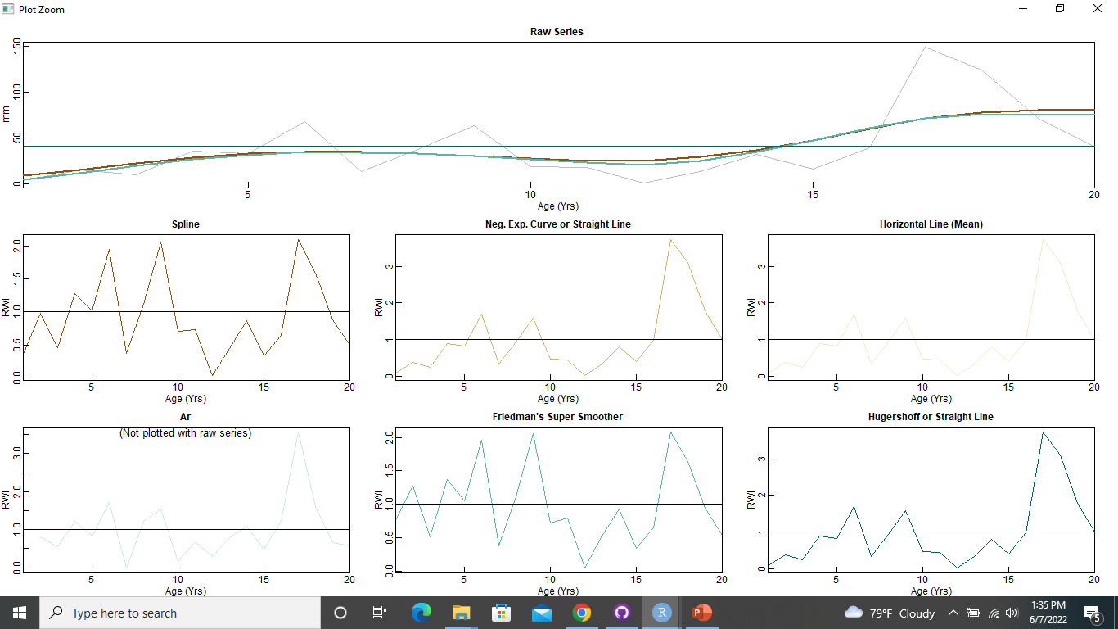
2002-2021 August Roost

Slide 7
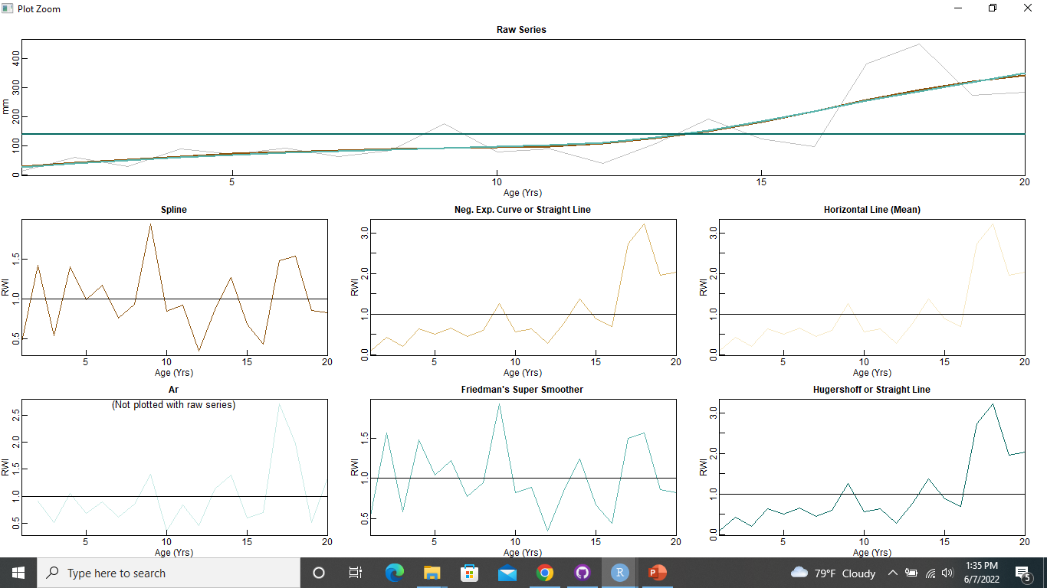
2002-2021 September Roost

Slide 8
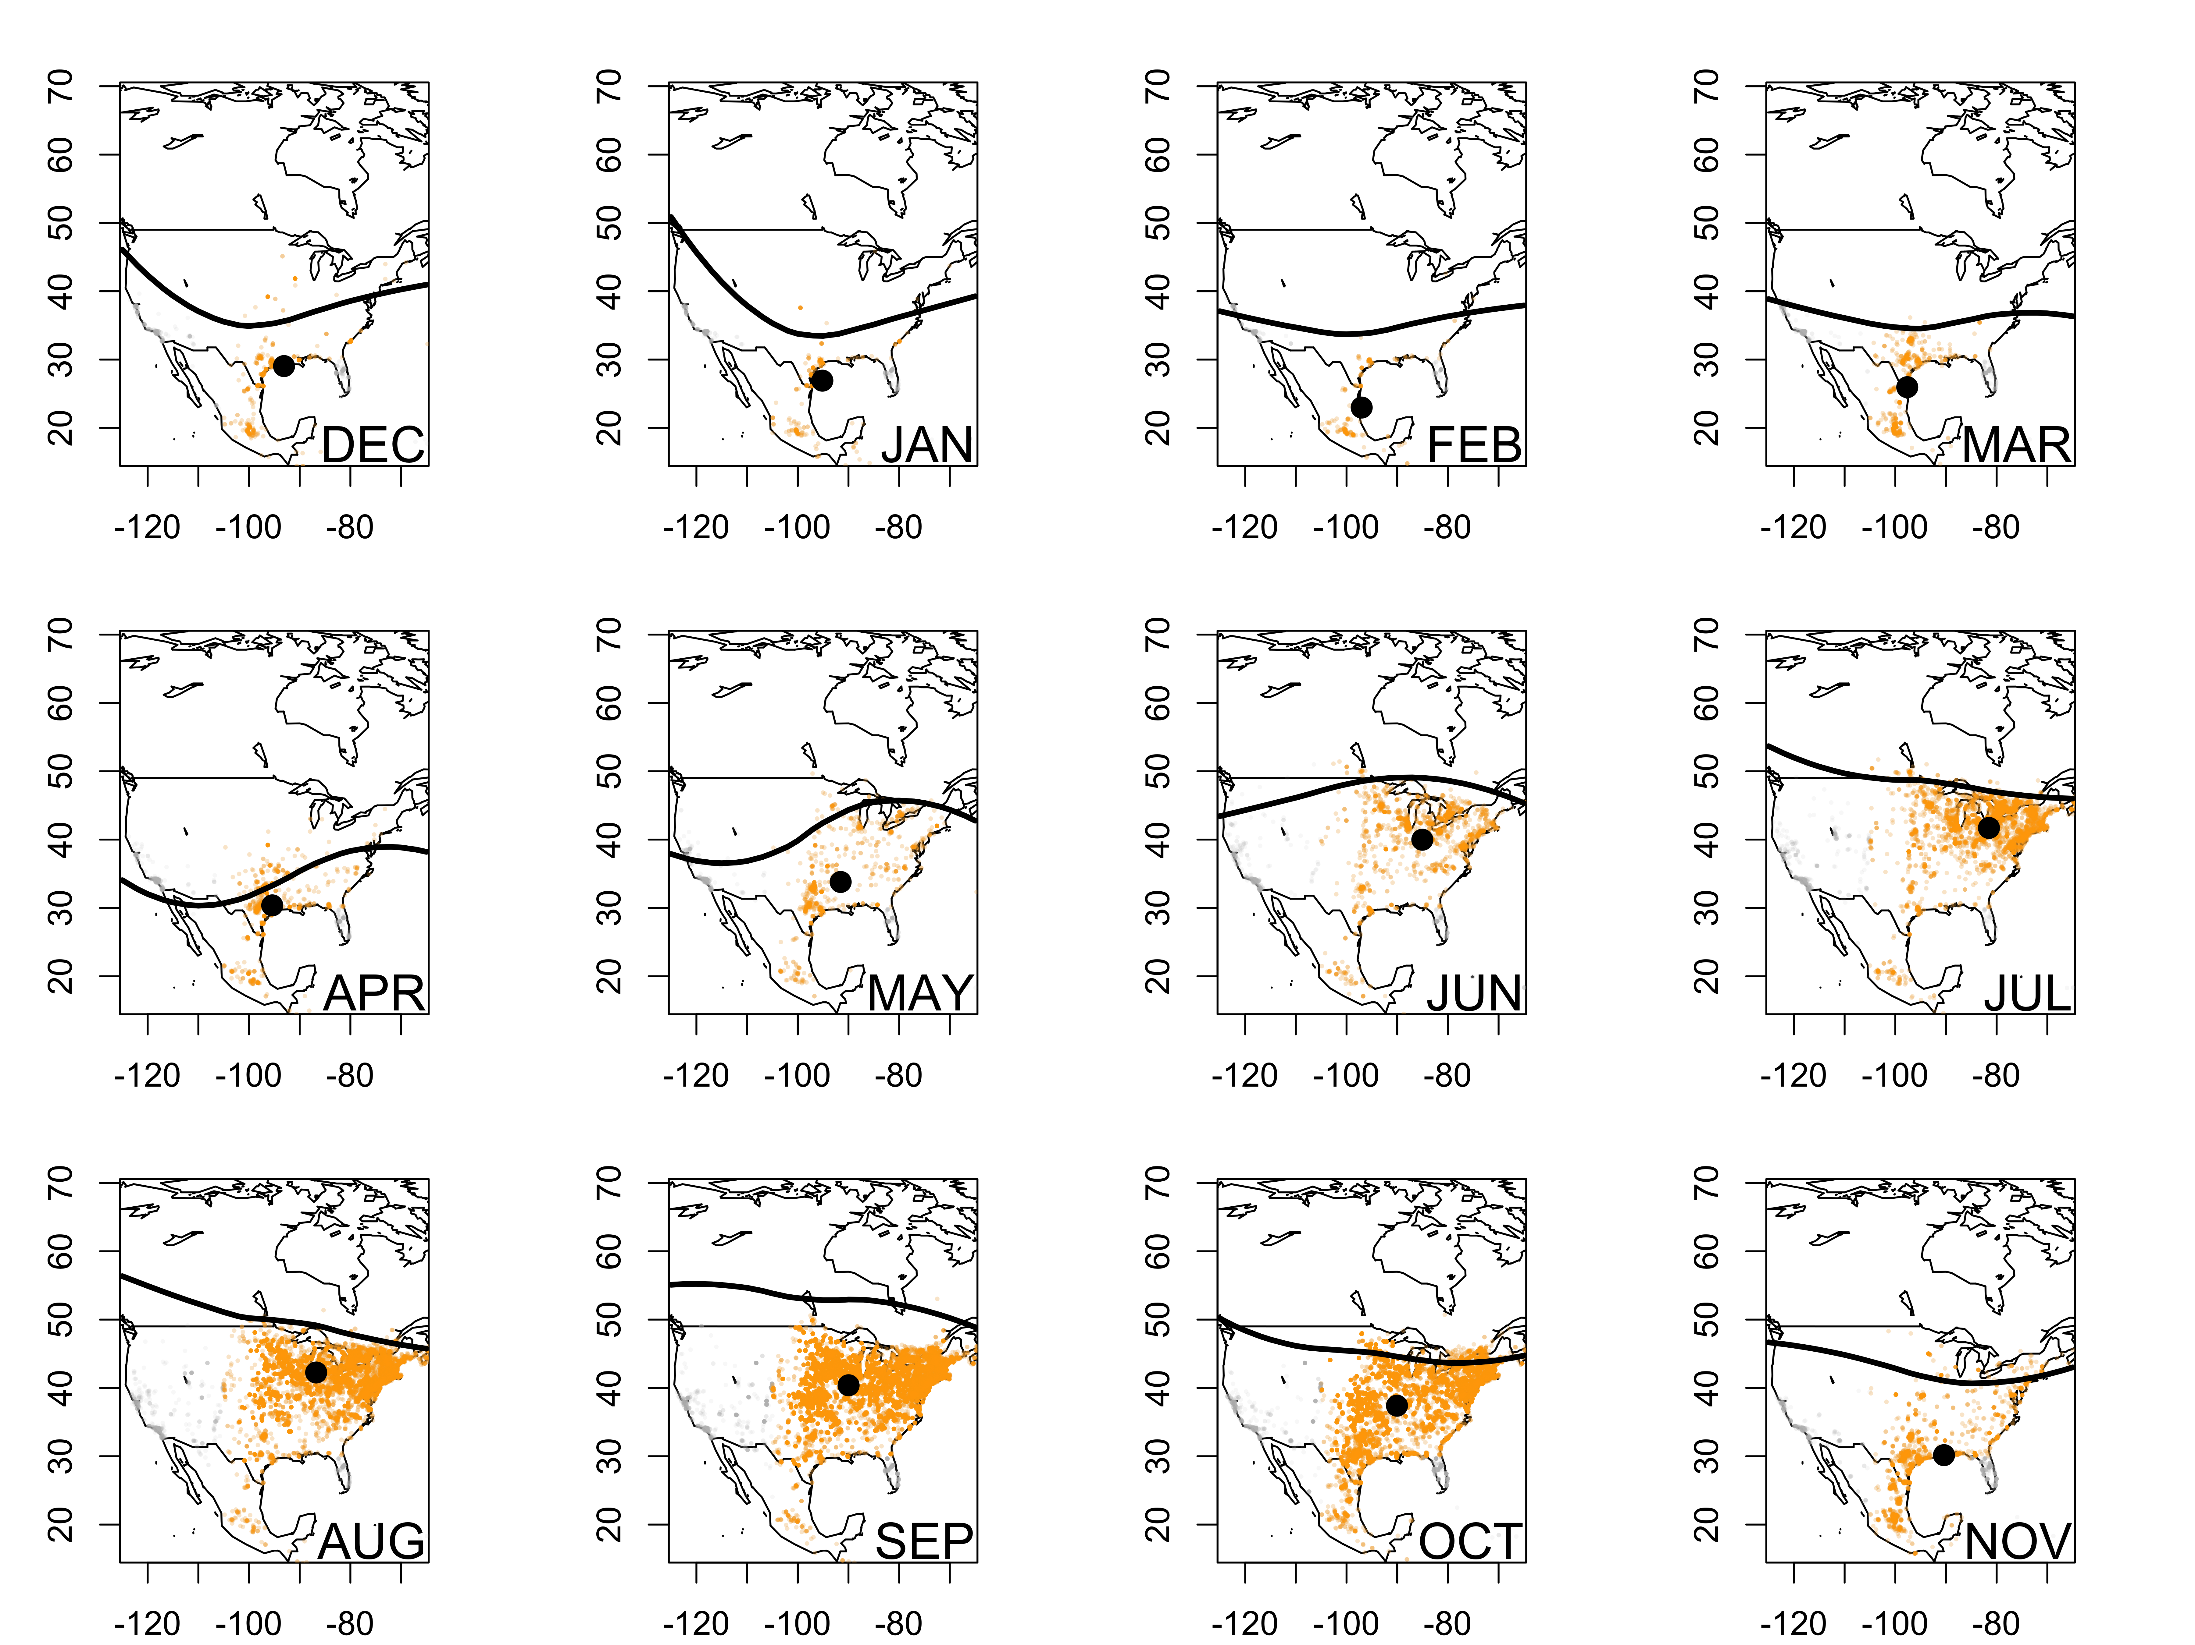
Fig. 2
The position of the jet stream overlaps with the monarch migration and is highly variable month to month and year to year. This position, and coinciding monarch life cycle and range, may have profound importance on migration success.
plot edit: grey, underneath orange (just aug) jet over whole domain (-125to 65)
2002-2019 time period- check gbif
Notes:
pull out the key months
Valerie- major thoughts?
depends what message
(jet between climate and weather and space – instrument of doom climate change – wobble )
little inputs accumulate

Slide 9
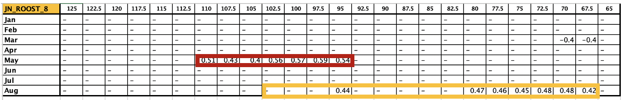
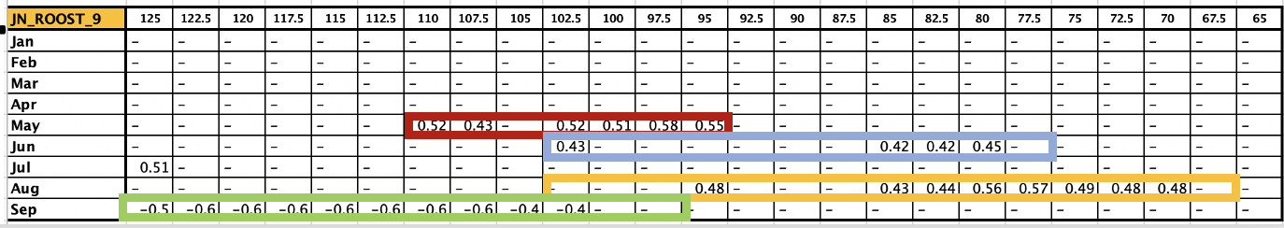
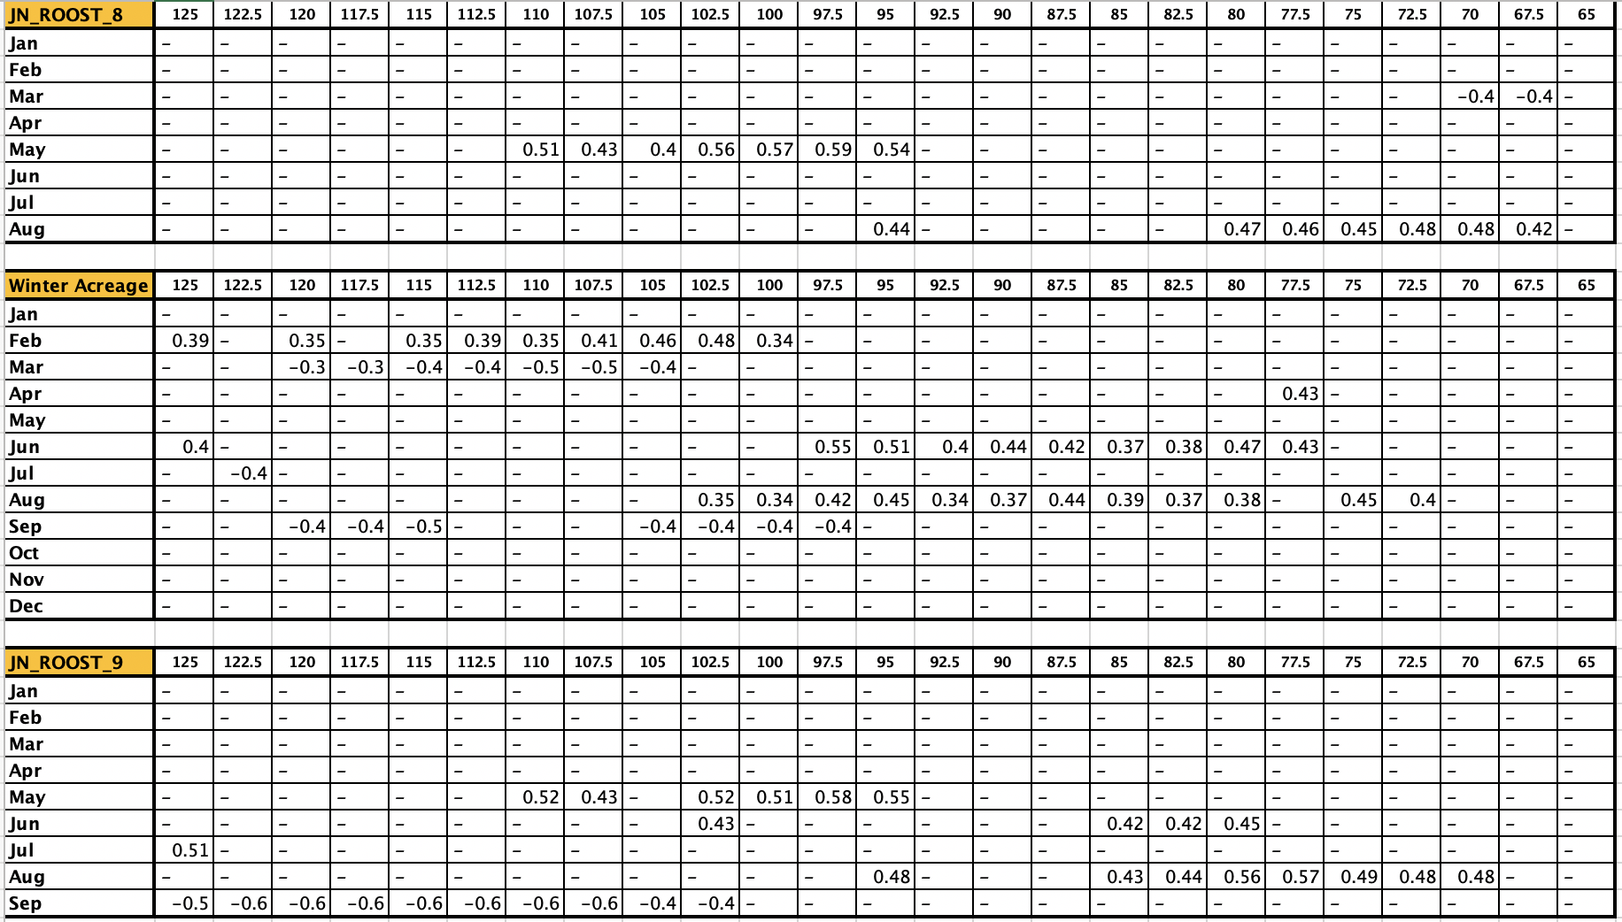
This is over the same period 2002-2019 for all indices- winter acreage goes back further
Supplement Table 1
Notes:
reorder winter below
(table into supplemental- put in all correlations )
early weather leads to success
because we don’t have a good time series for may June July (ref- disconnect between summer population and overwintering)

Slide 10
Fig. 3
The latitudinal variability of the jet stream in summer and fall influences the fall monarch migration. A) Initial fall migration index corresponds positively to May June August and negatively with September. B) Final return overwintering success corresponds positively to June August and negatively with September. A) and B) share windows of overlap.
Sup Table 1
in figure form
May June August September
Overlap
August
A)
September roost
B)
Winter Acreage
Notes:
pull out the key months
Valerie- major thoughts?
depends what message
(jet between climate and weather and space – manifestation of climate change – wobble )
little inputs accumulate

Slide 11
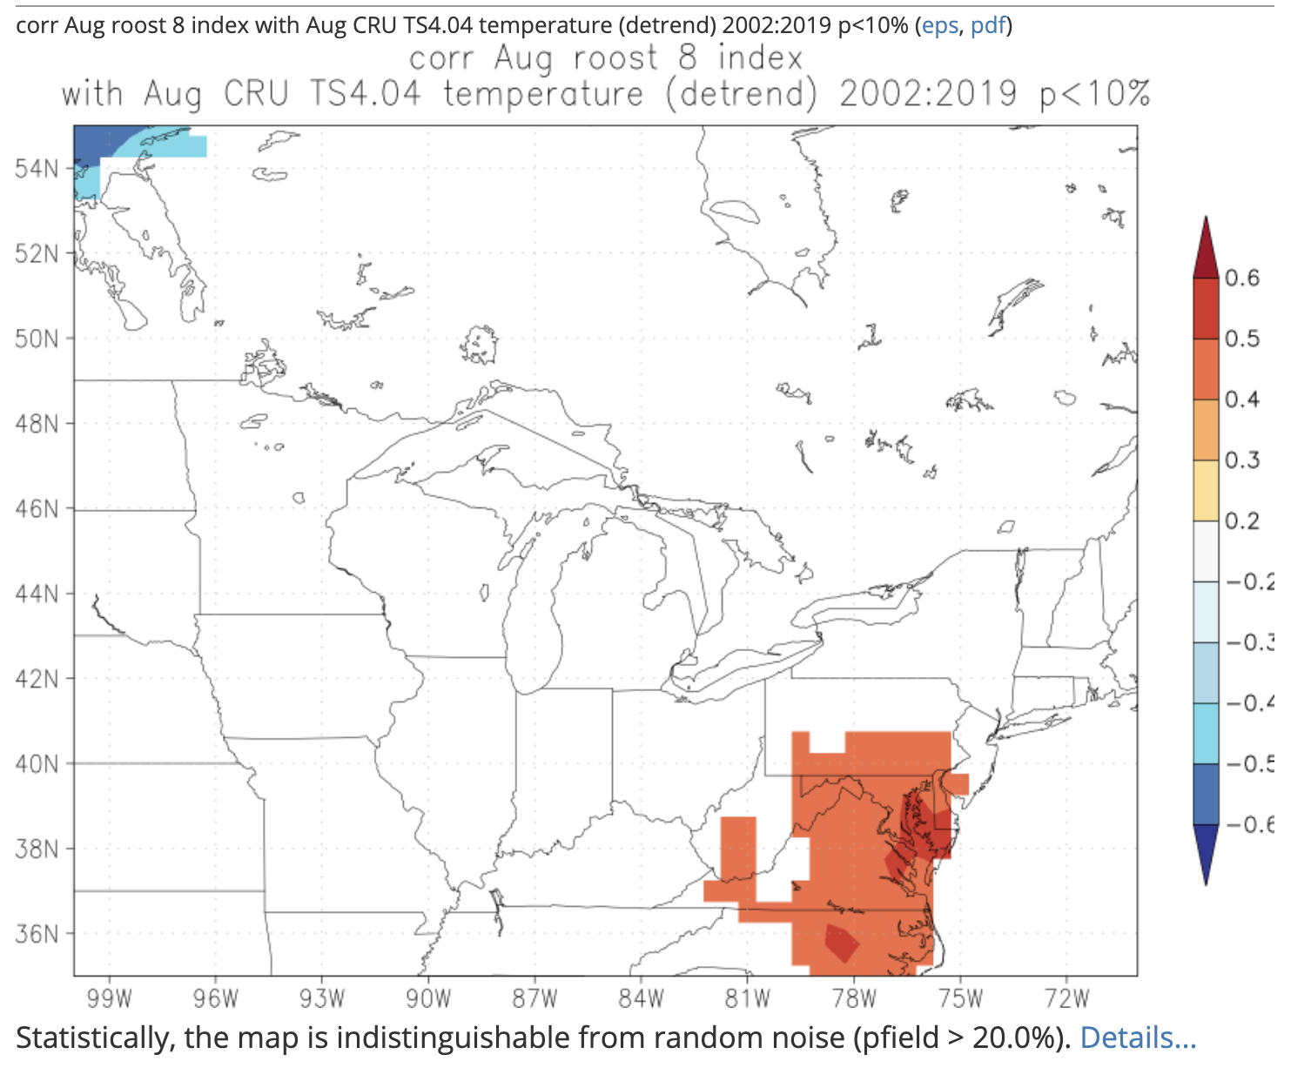
The jet stream position influences climate, especially minimum temperatures, at key migration times and places. (A northern jet stream can warm minimum temperatures which benefits monarch migration return)
Fig. 4
CHANGE TO TMIN
Winter acreage correlated with average August temperature
August Jet stream correlated with average August temperature
August Jet stream position positively correlated with winter acreage and august roost index
August roost index
correlated with average August temperature
ADD SEPTEMBER
Parse out food availability/ habitat/development in text
spatial extent to match

Slide 12
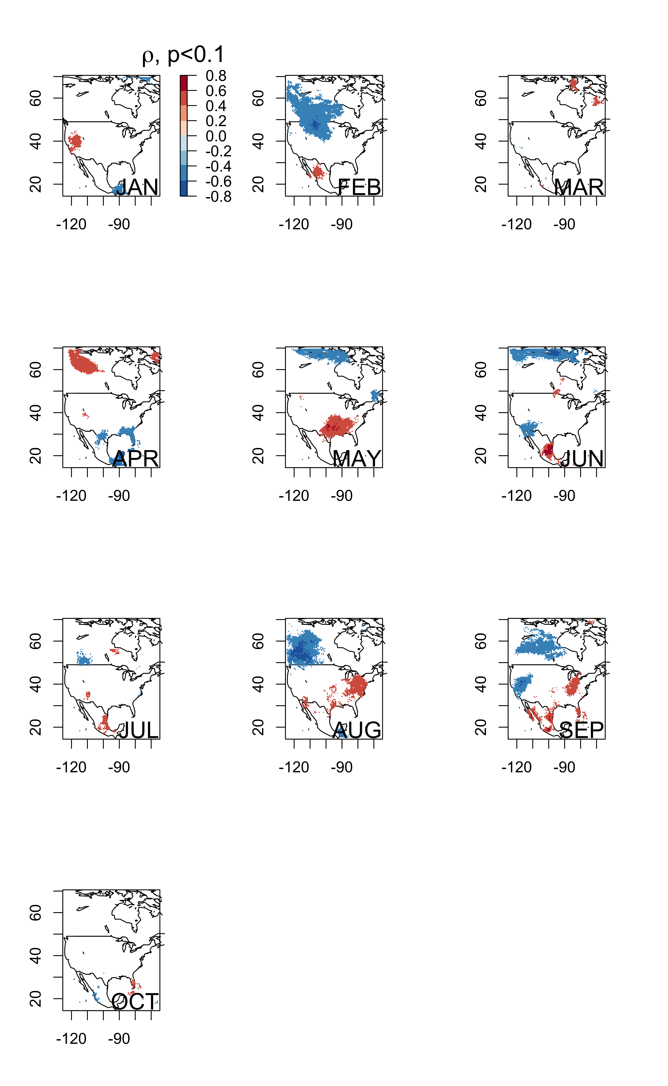
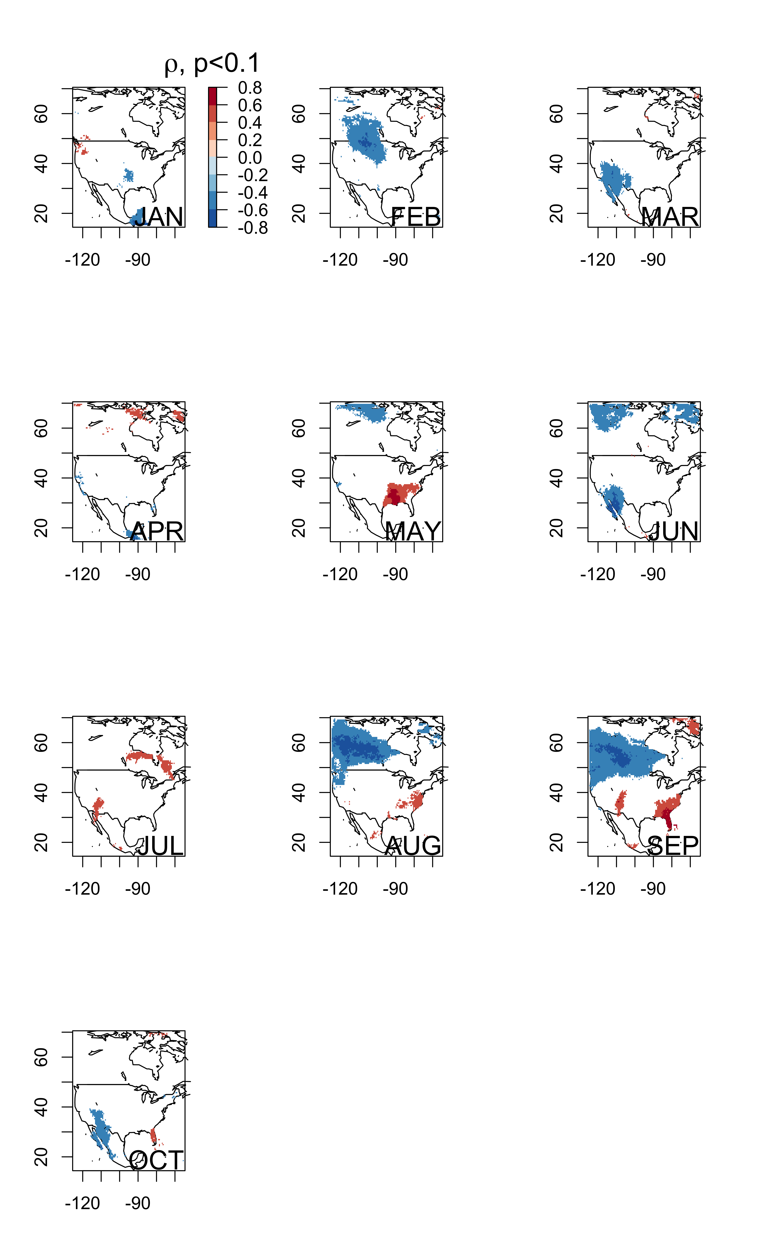
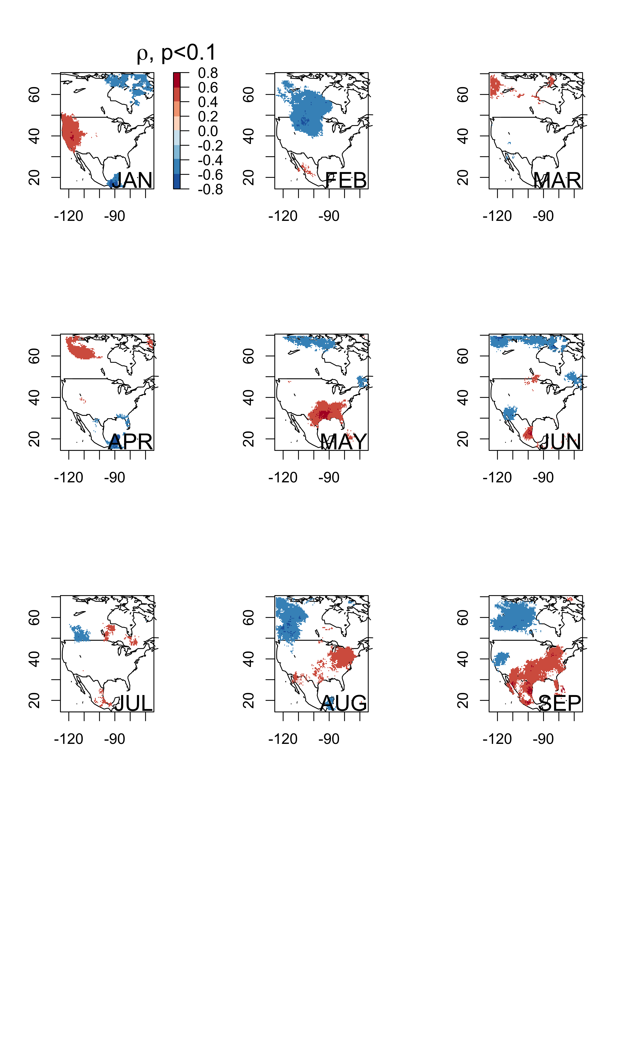
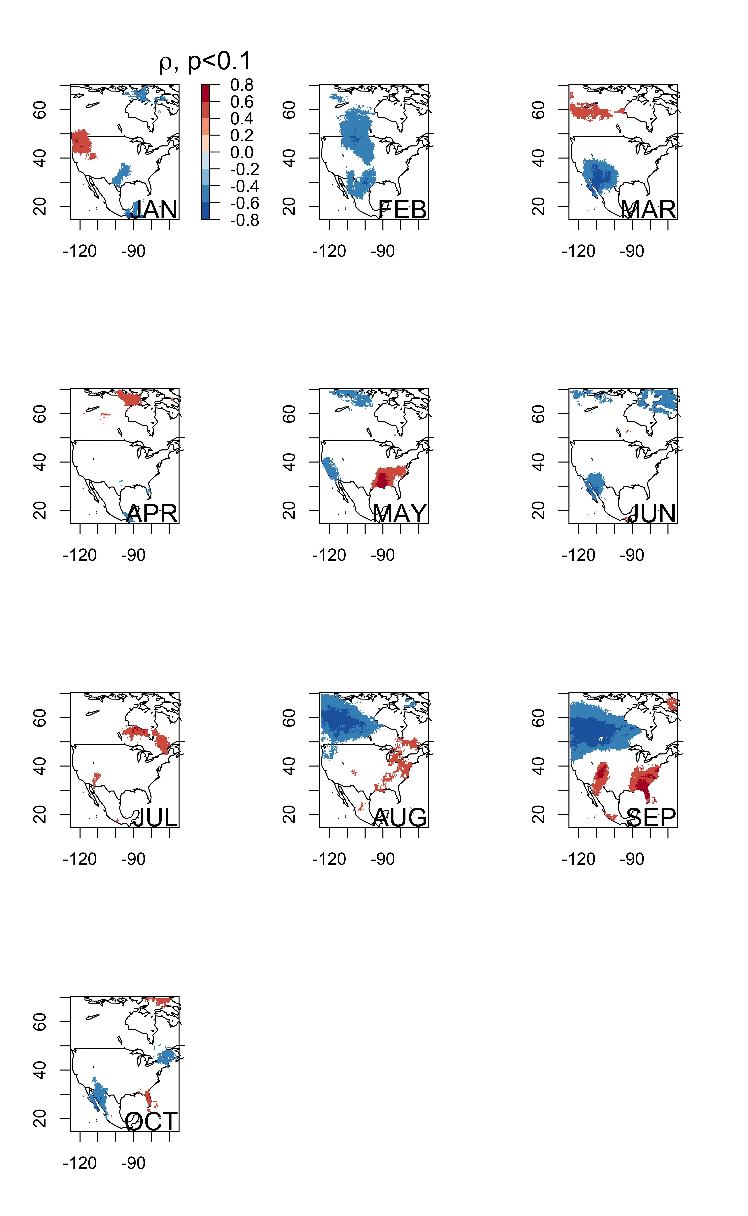
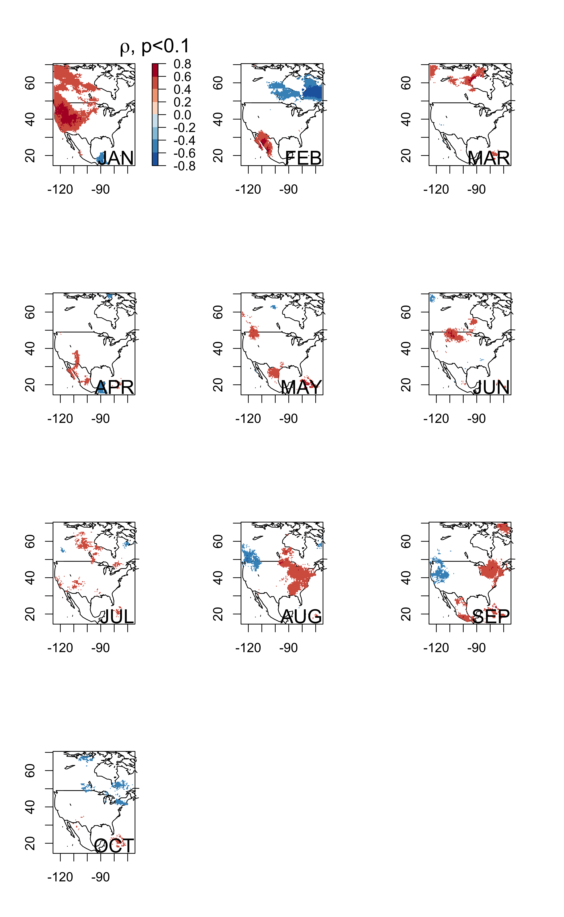
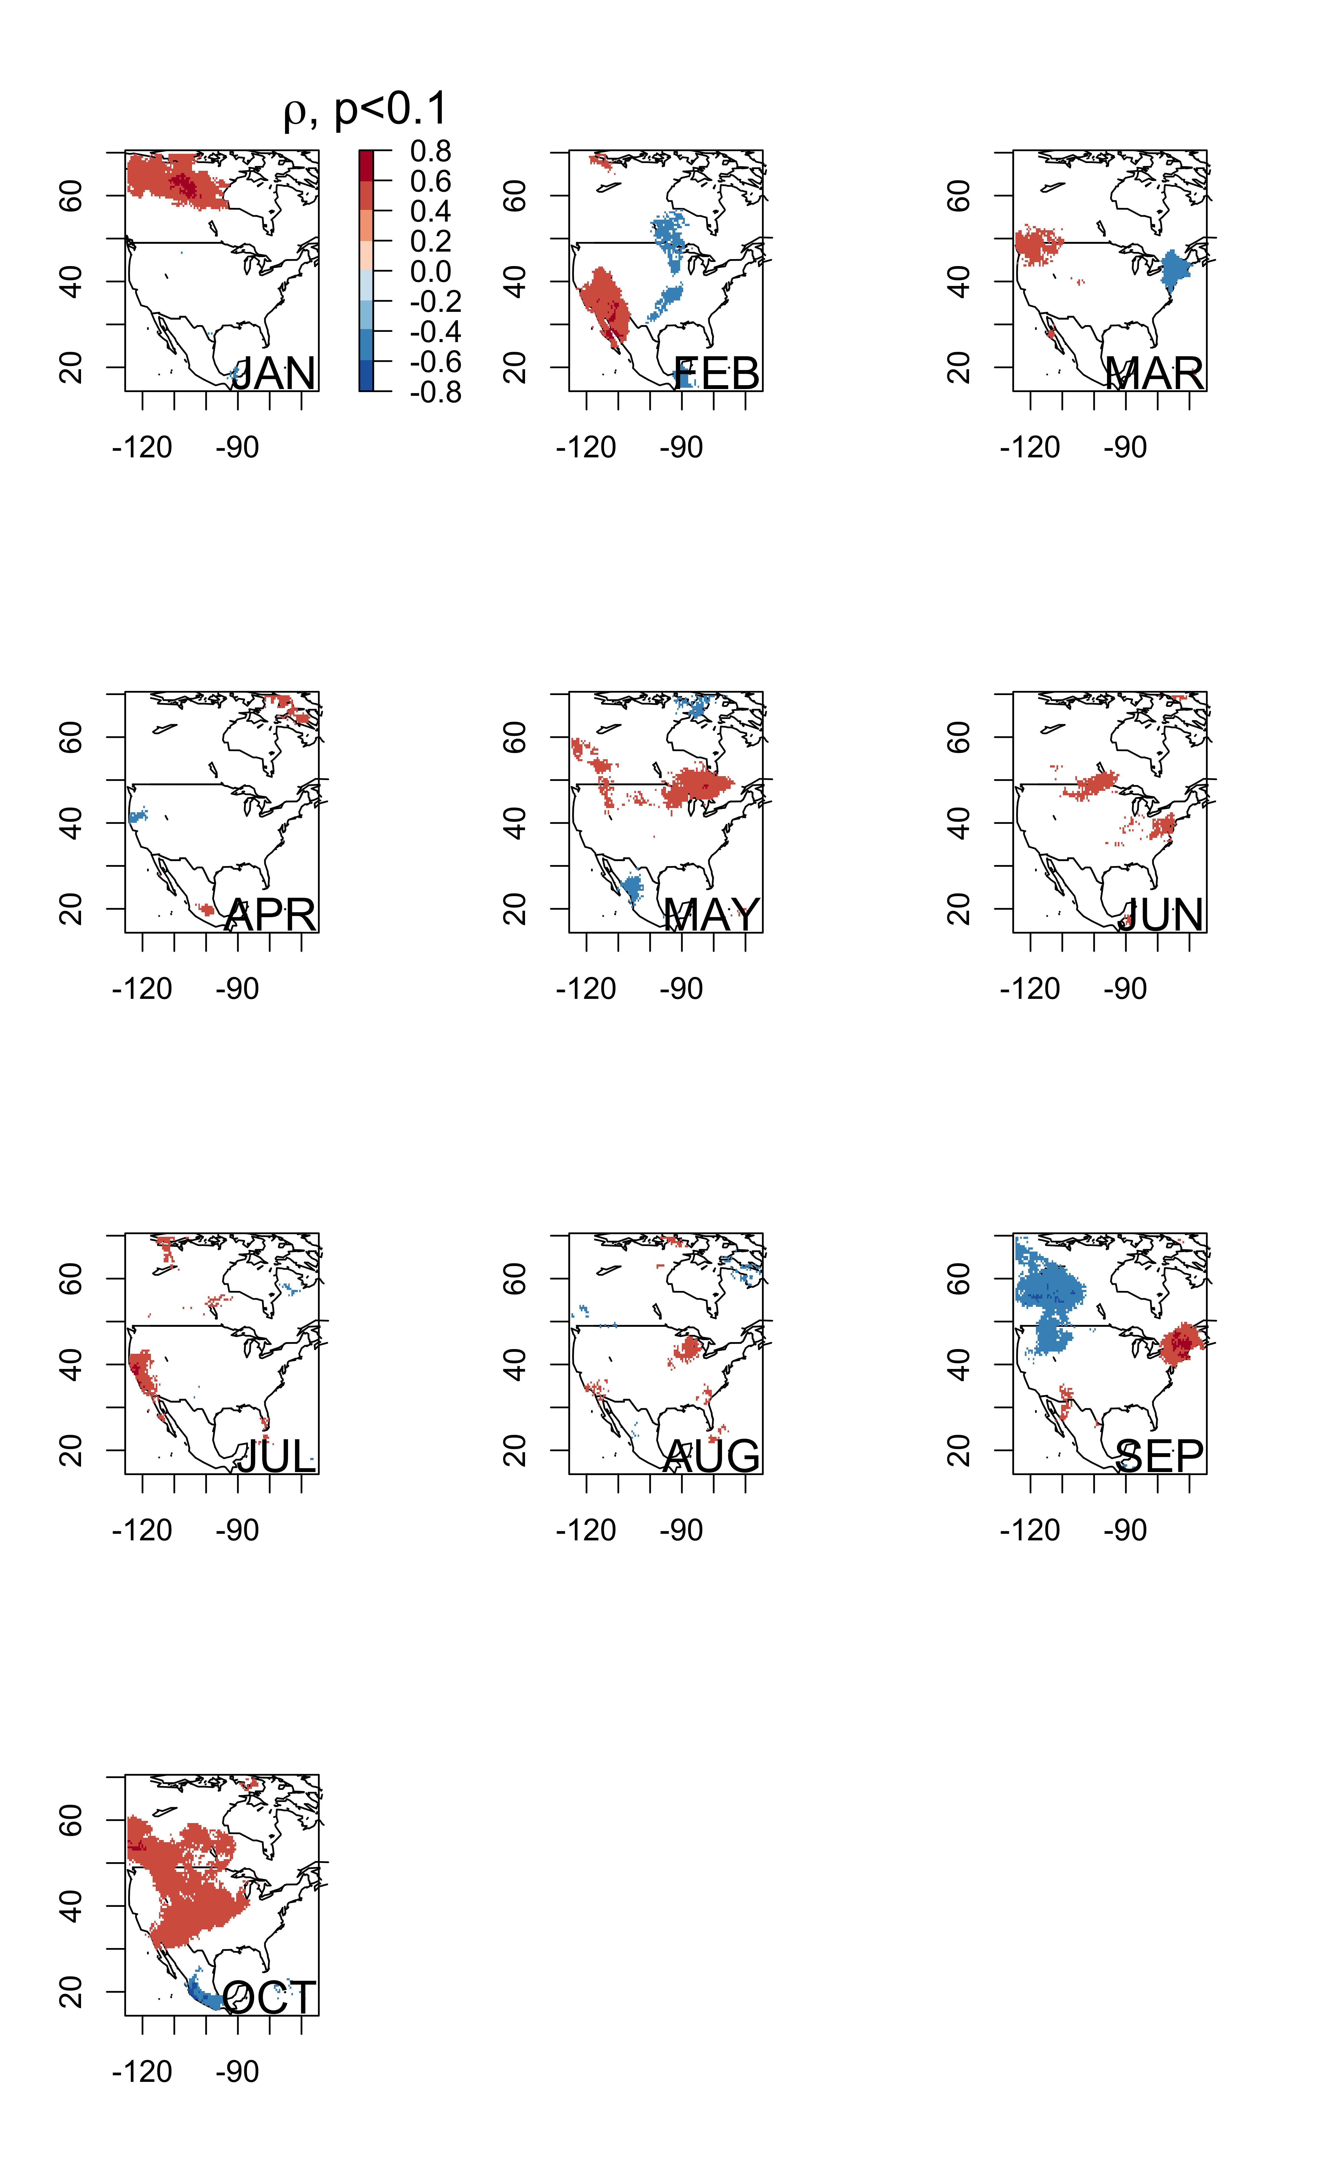
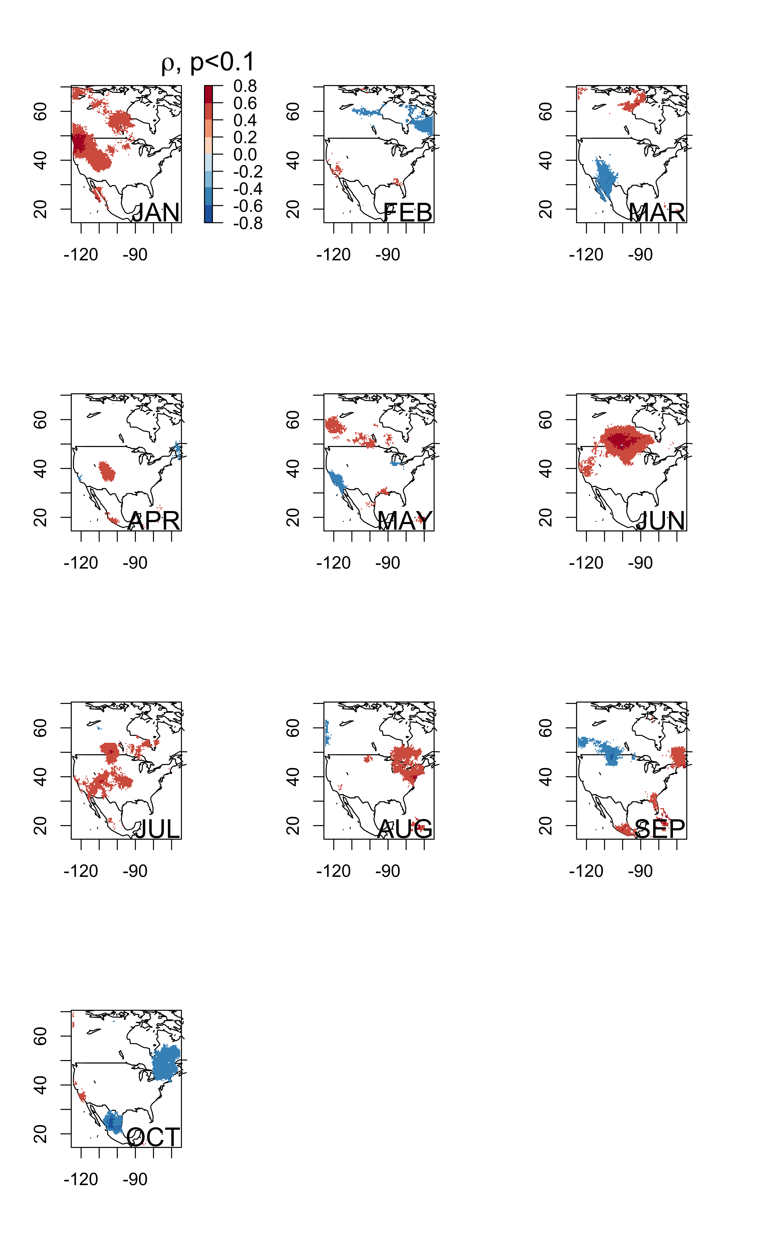
TMIN
TMAX
ROOST_8
ROOST_8
ROOST_9
ROOST_9
Winter
Winter
Jet Stream
windows blocked out and climate relationship underneath

Slide 13
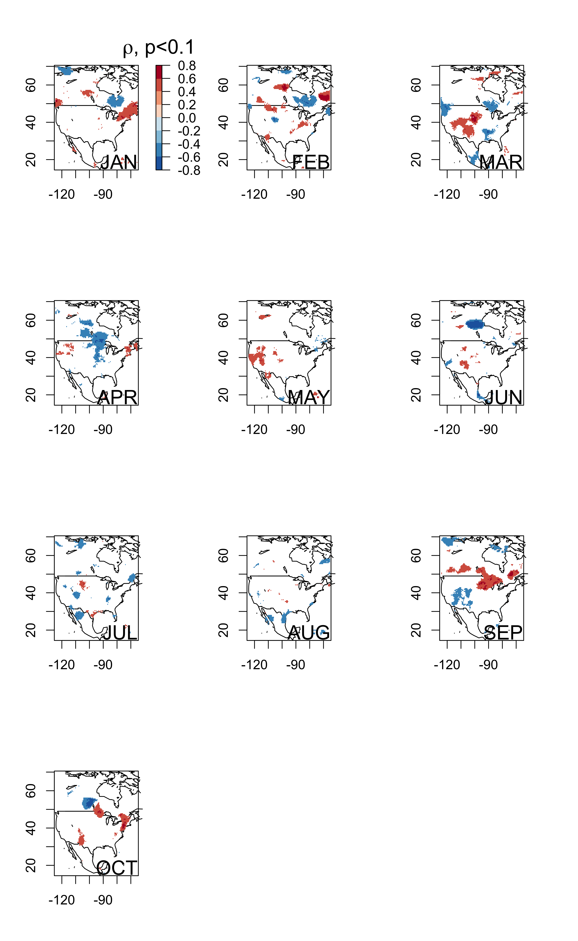
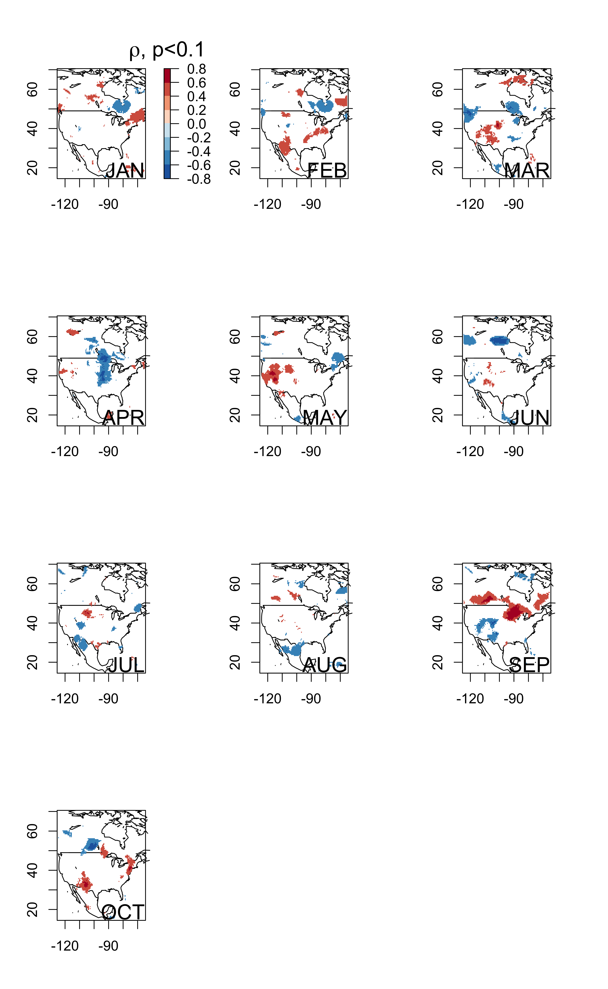
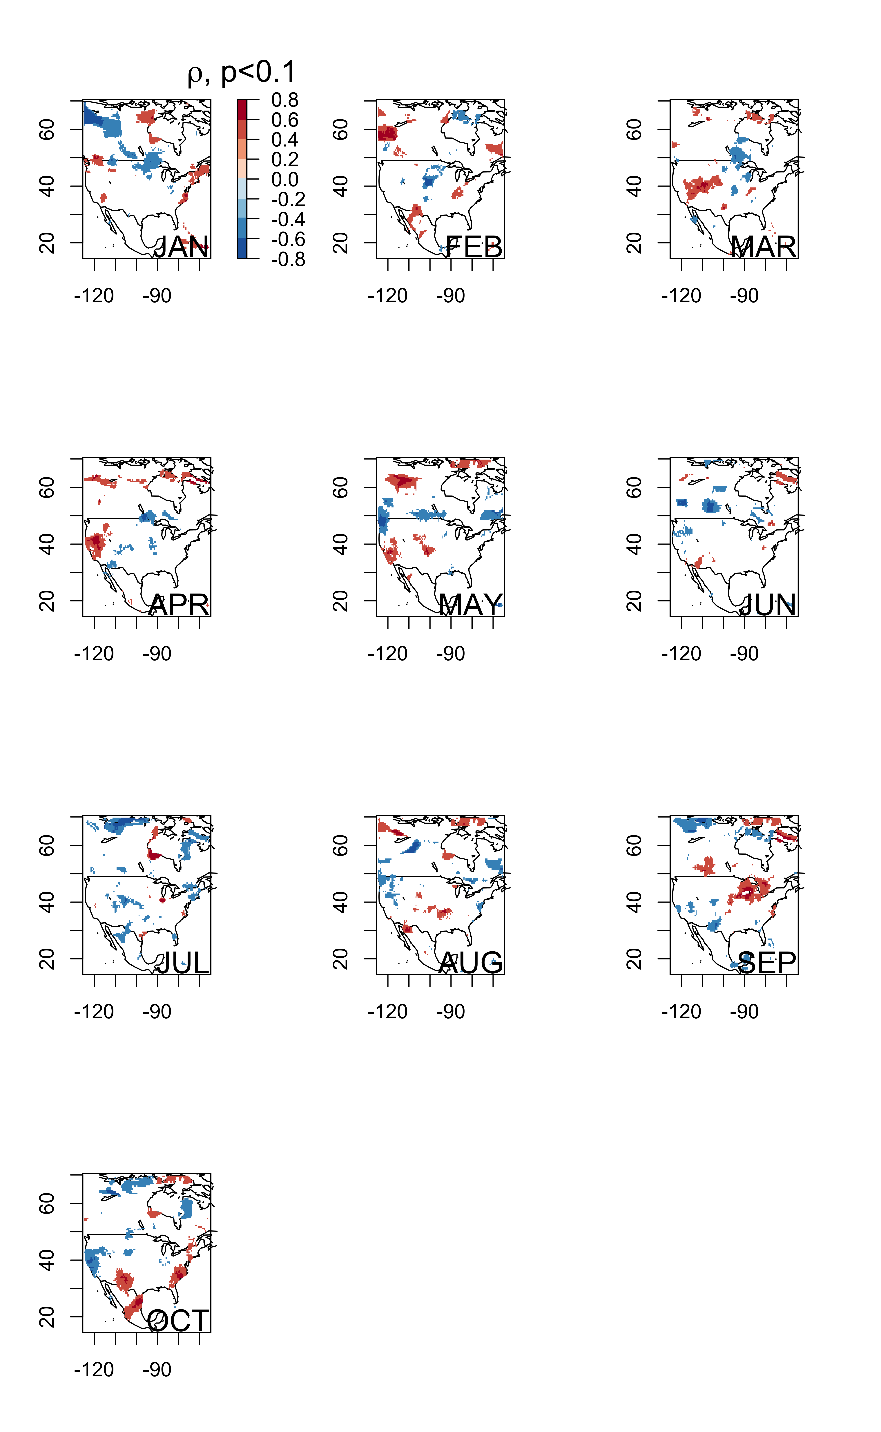
PREC
ROOST_8
ROOST_9
Winter
relative humidity?

Slide 14
Fig. 5
Nectar Resource/ Habitat/ Host plant
what is jet doing for plant resources during migration?
Greenness NDVI (Saunders et al 2019)
Does greenness correspond w Nectar Resources NPN Nectar connectors
maybe also look at ndvi and August and September roosting (could show signal over roosting grounds and leading up (May, June, August?)
winter correlation w august September etc. ndvi?

Slide 15
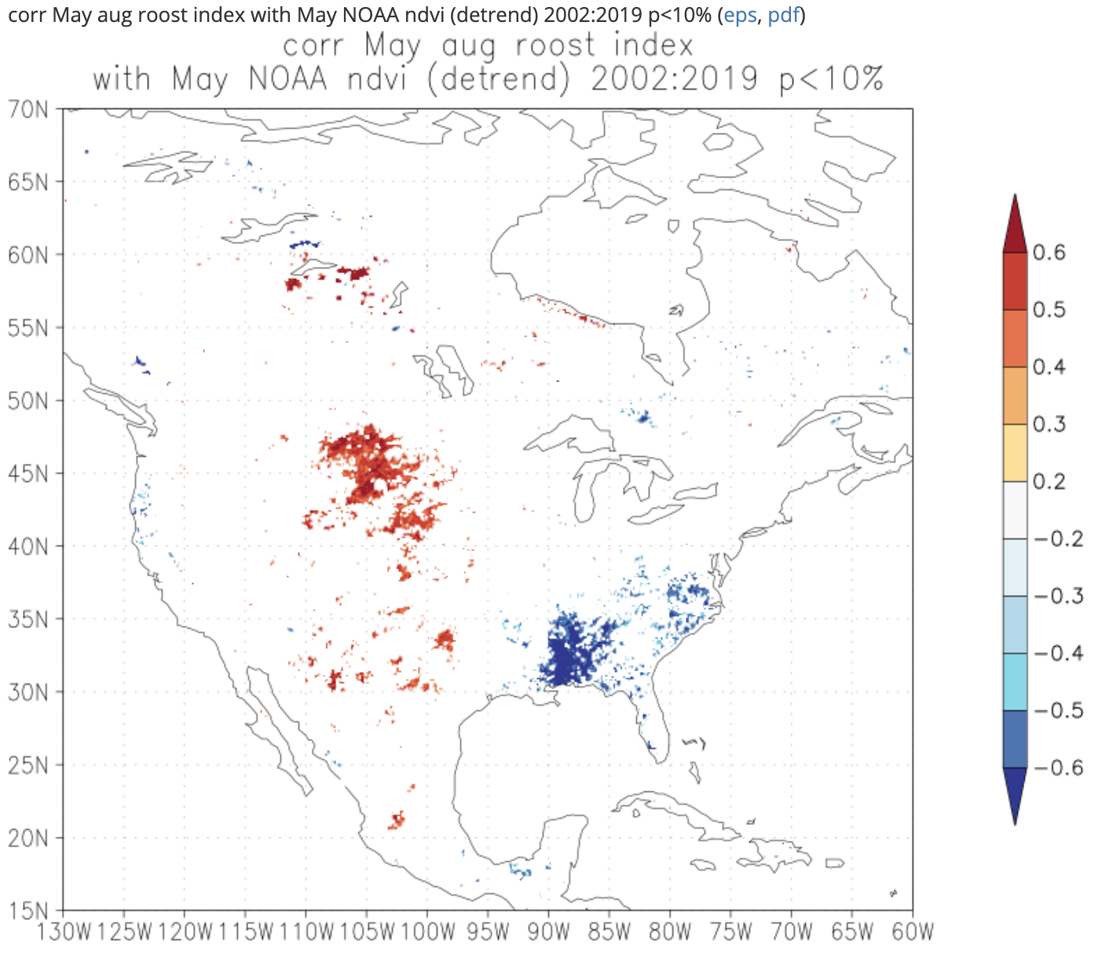
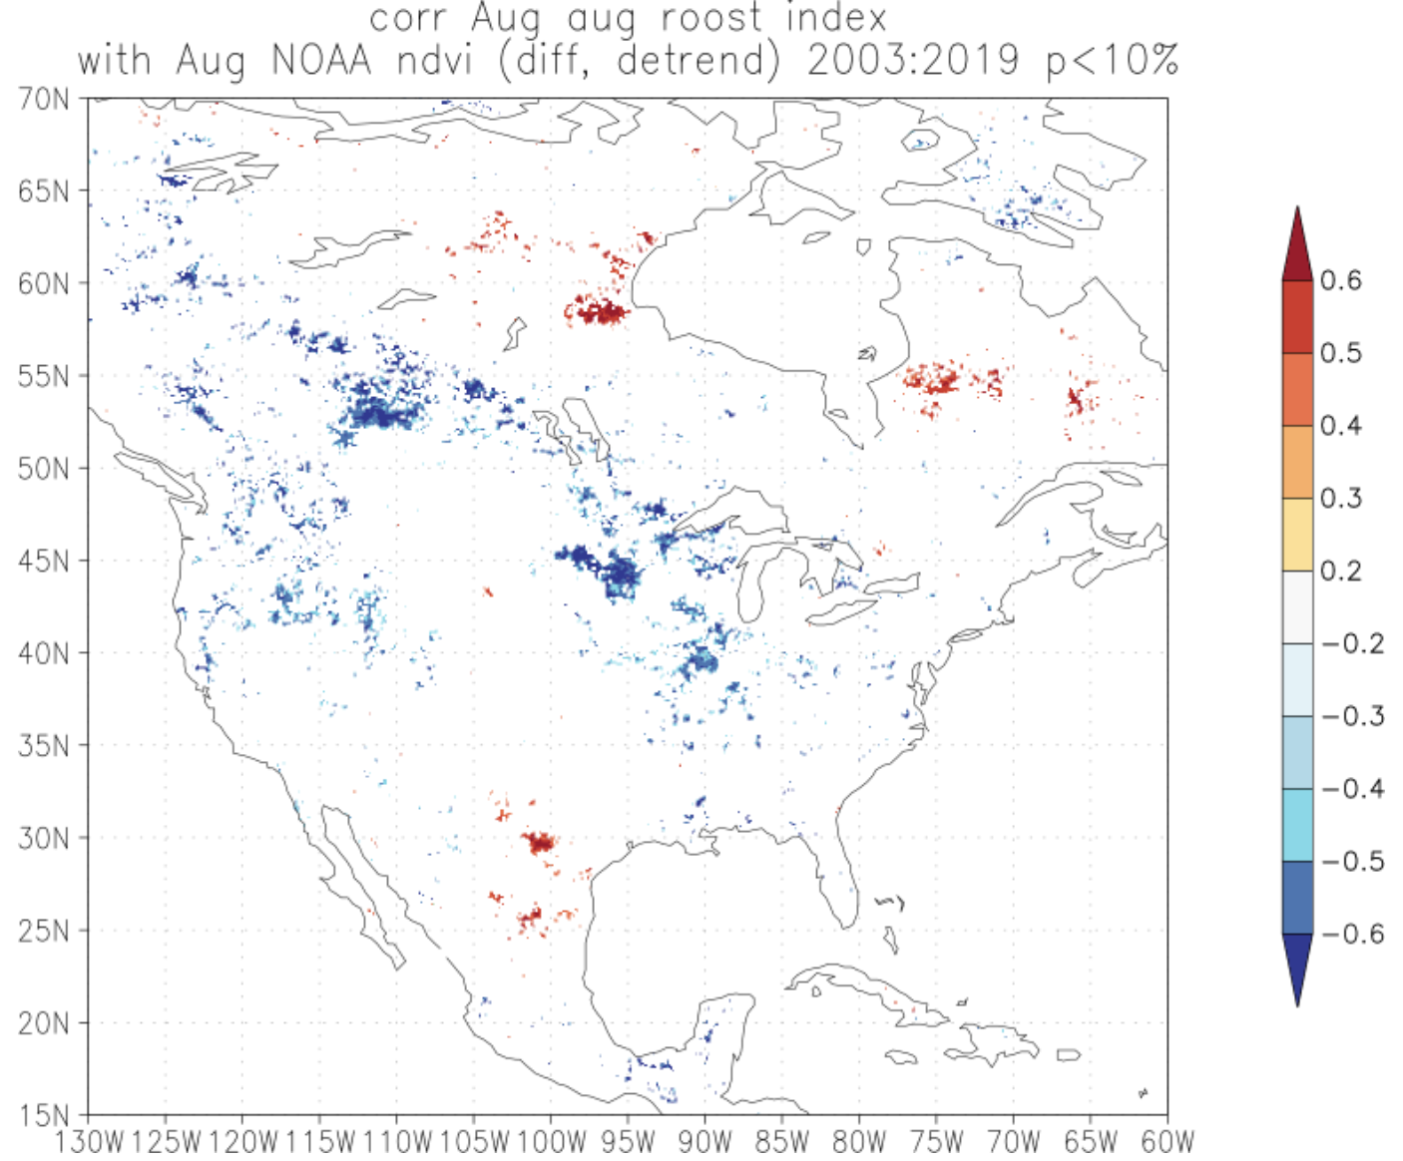
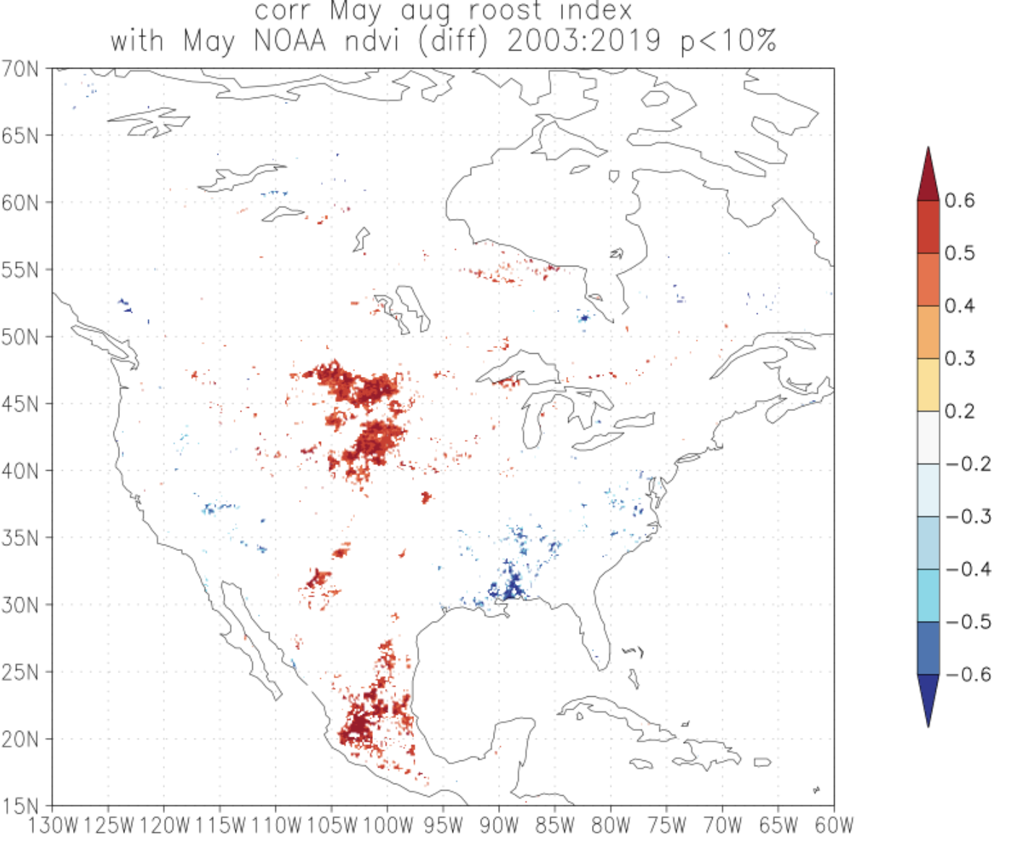
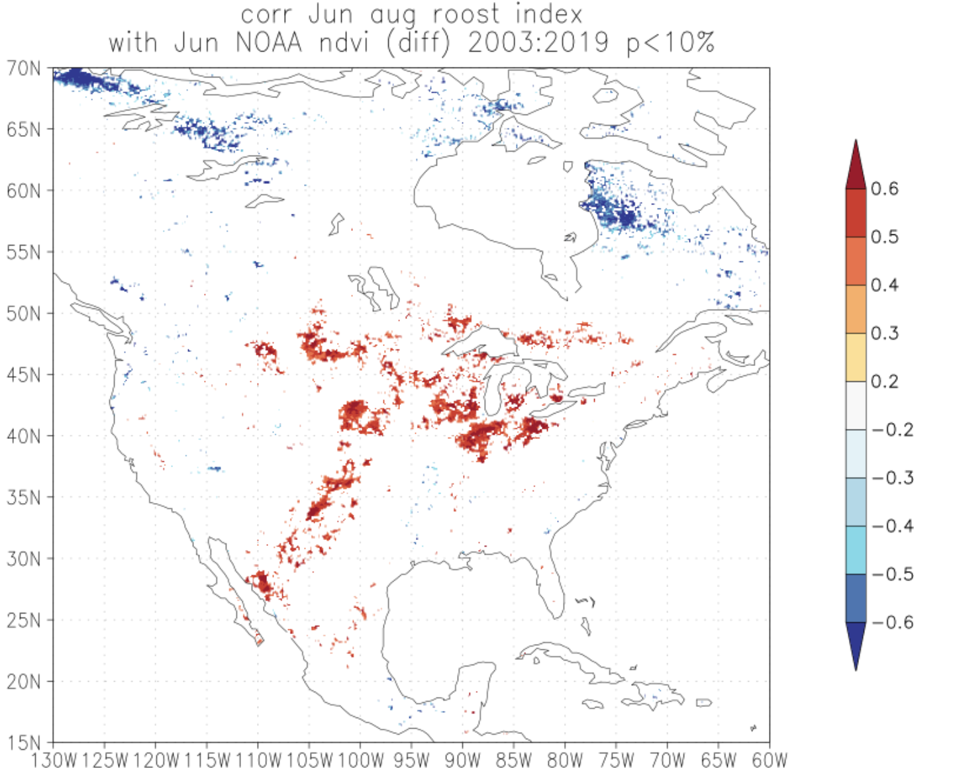
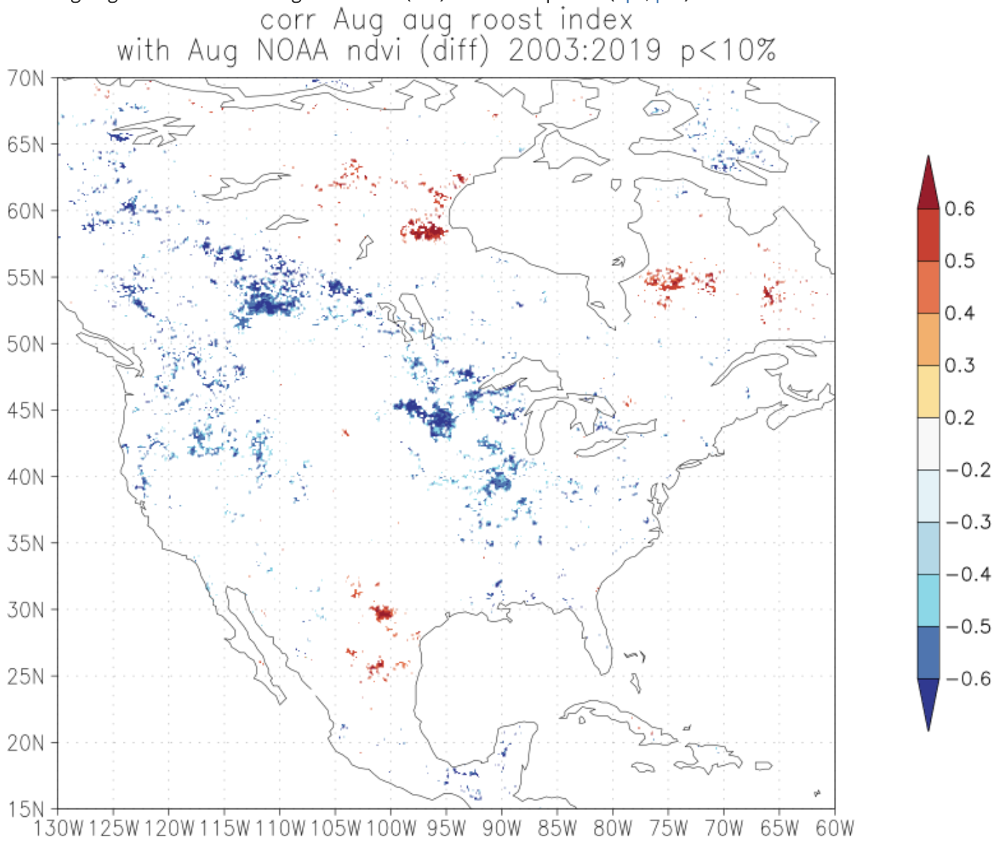
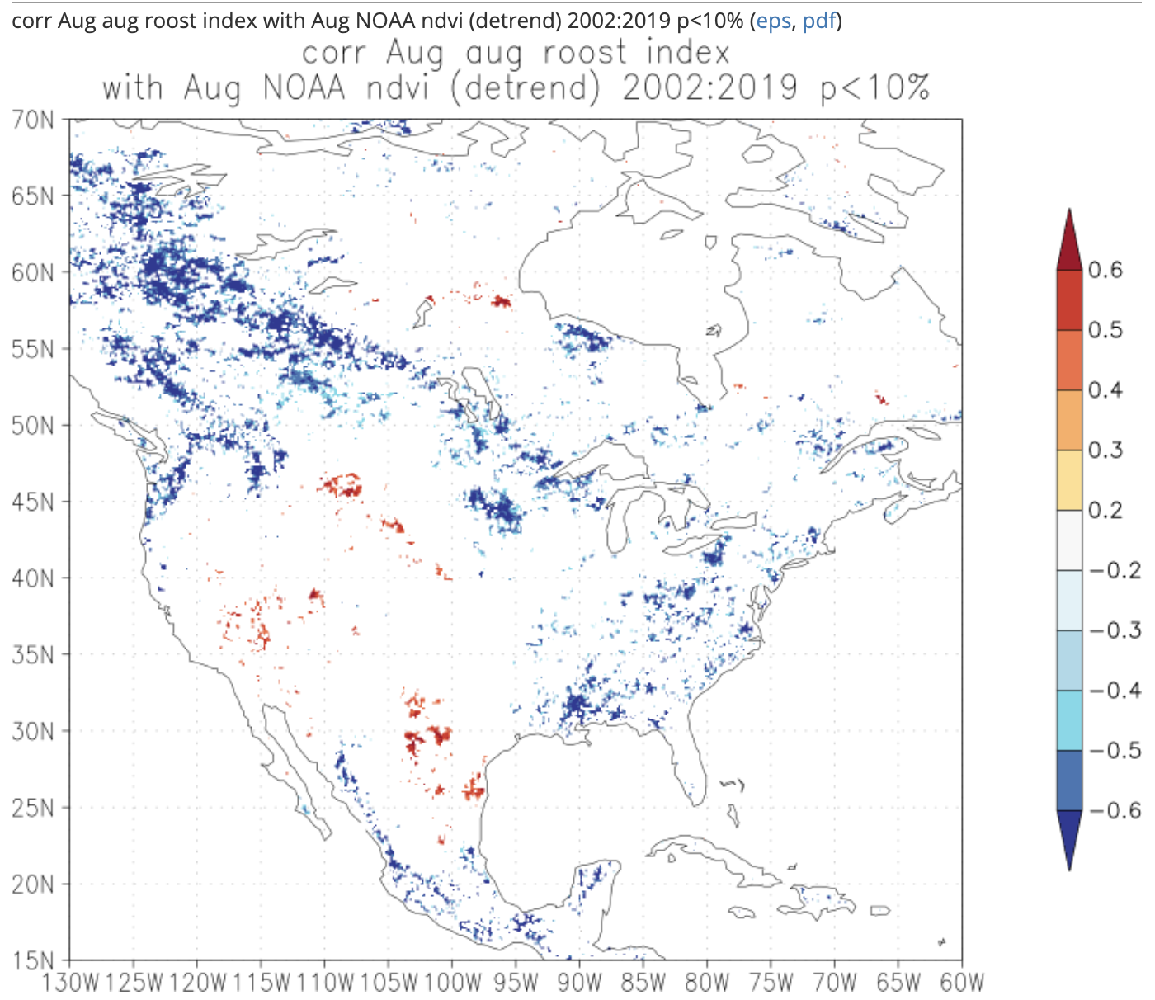
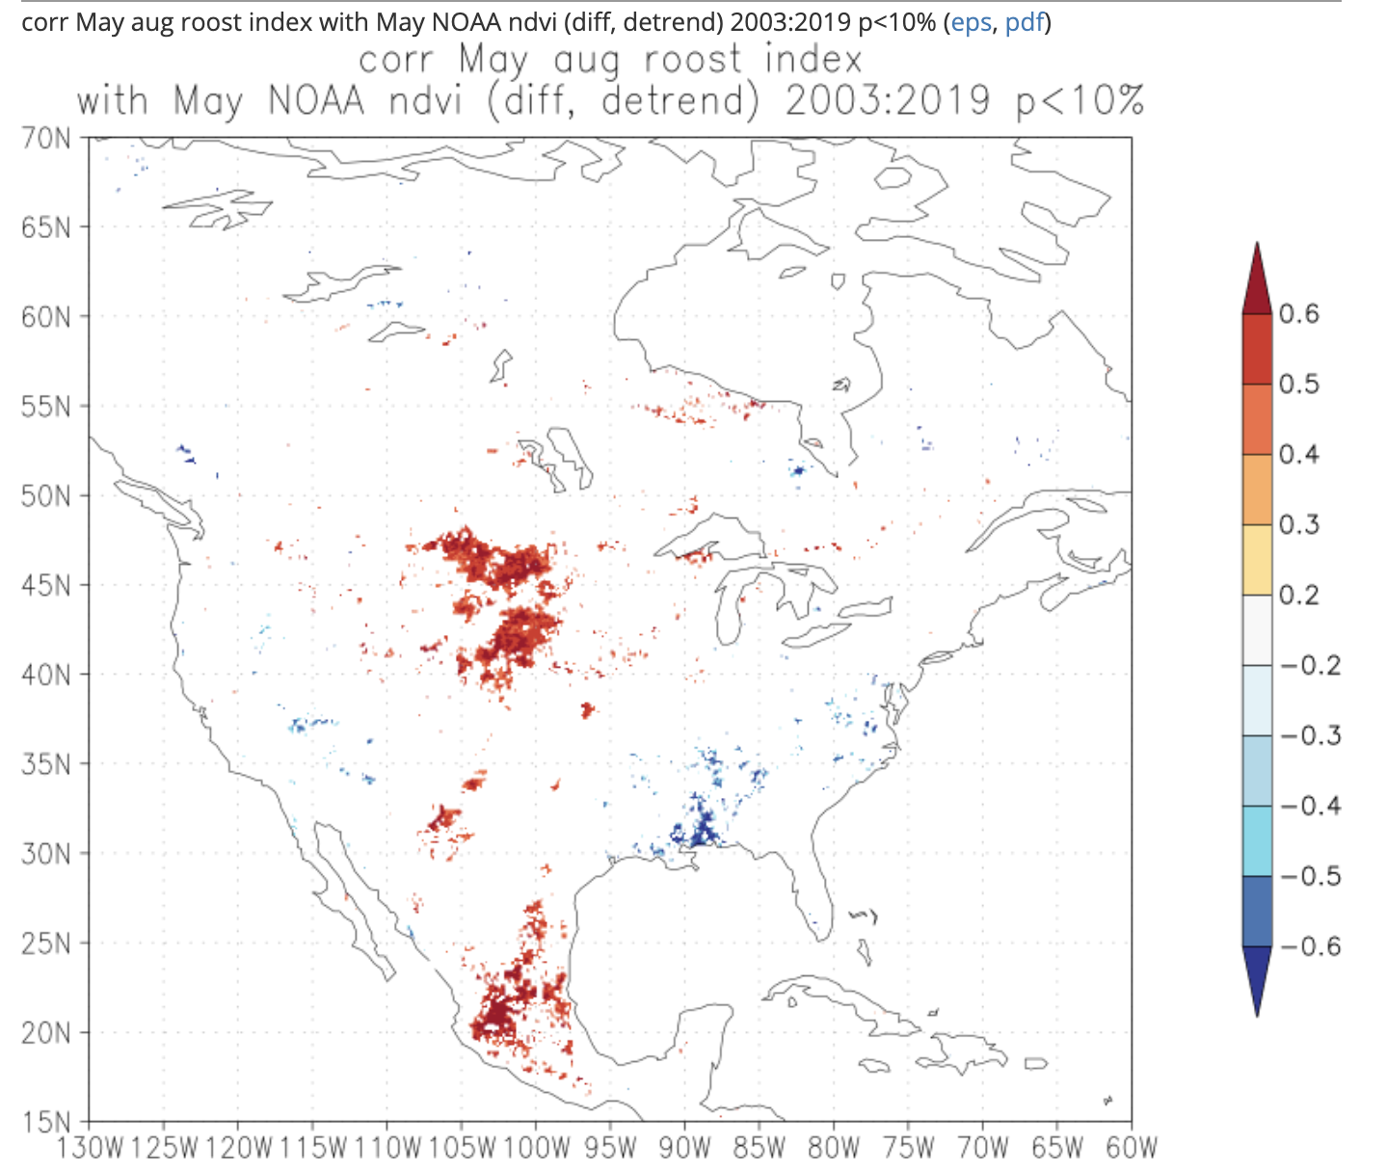
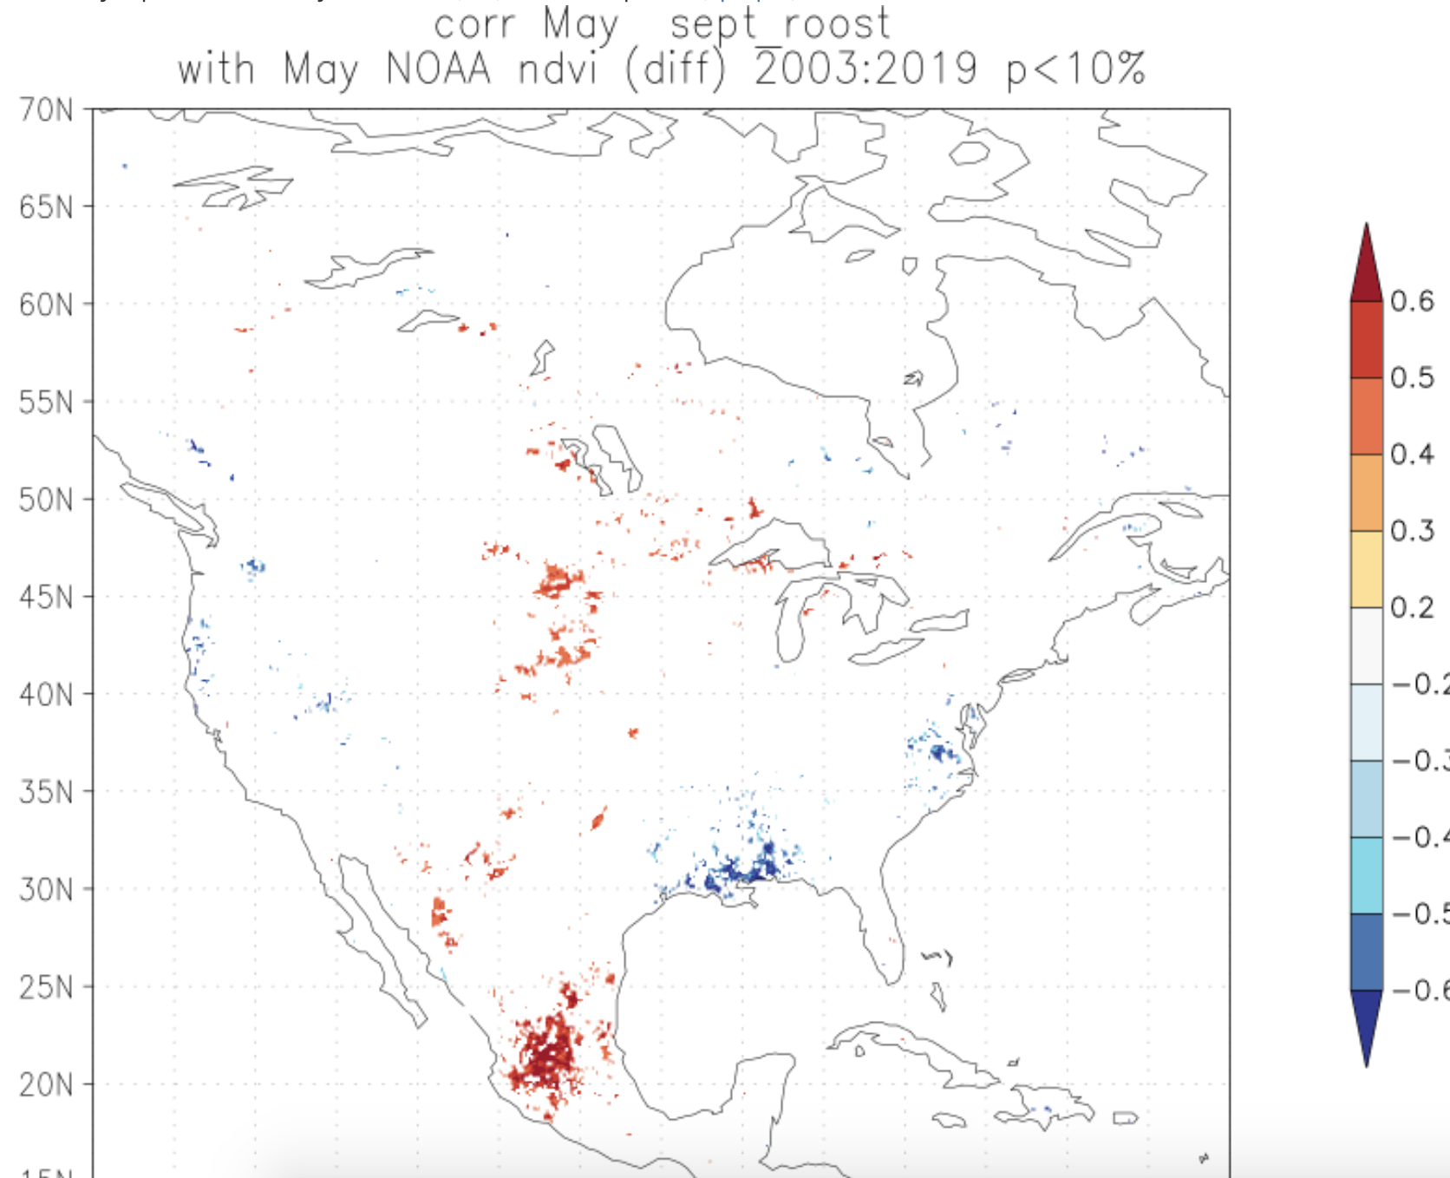
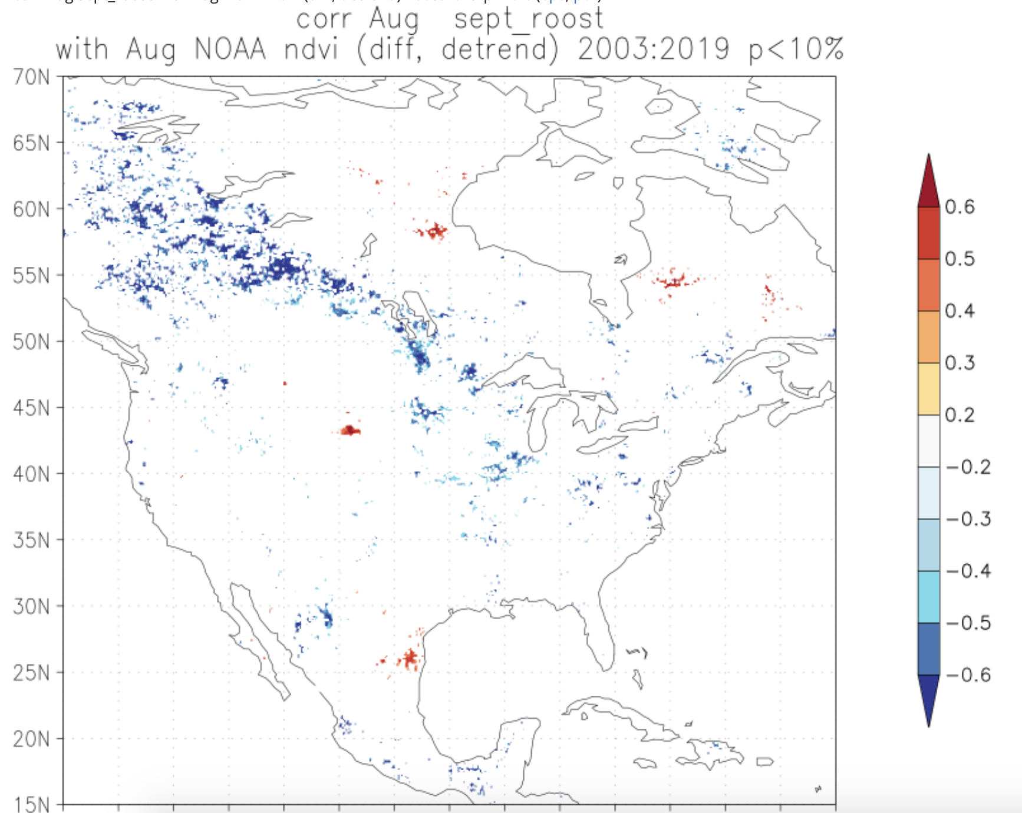
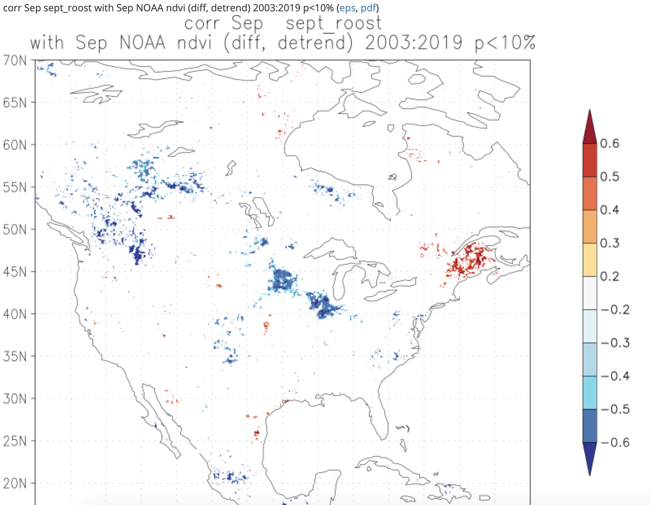
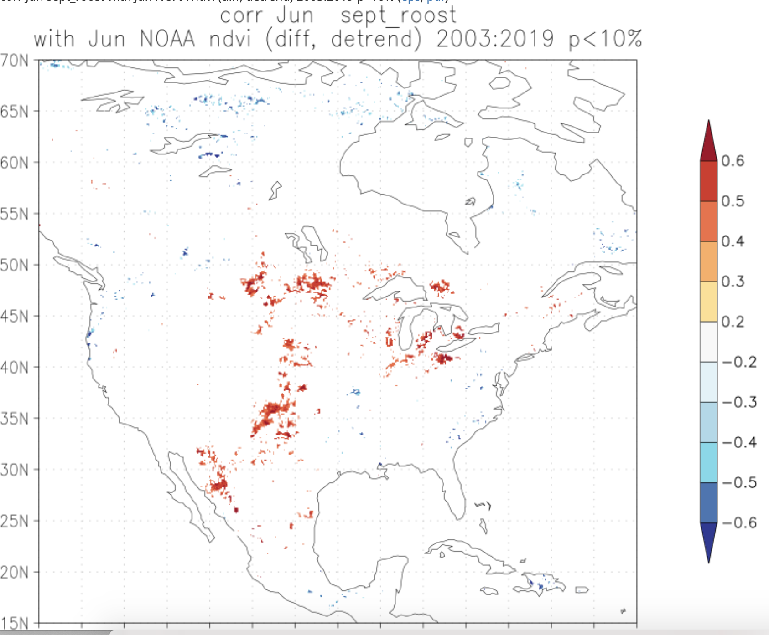
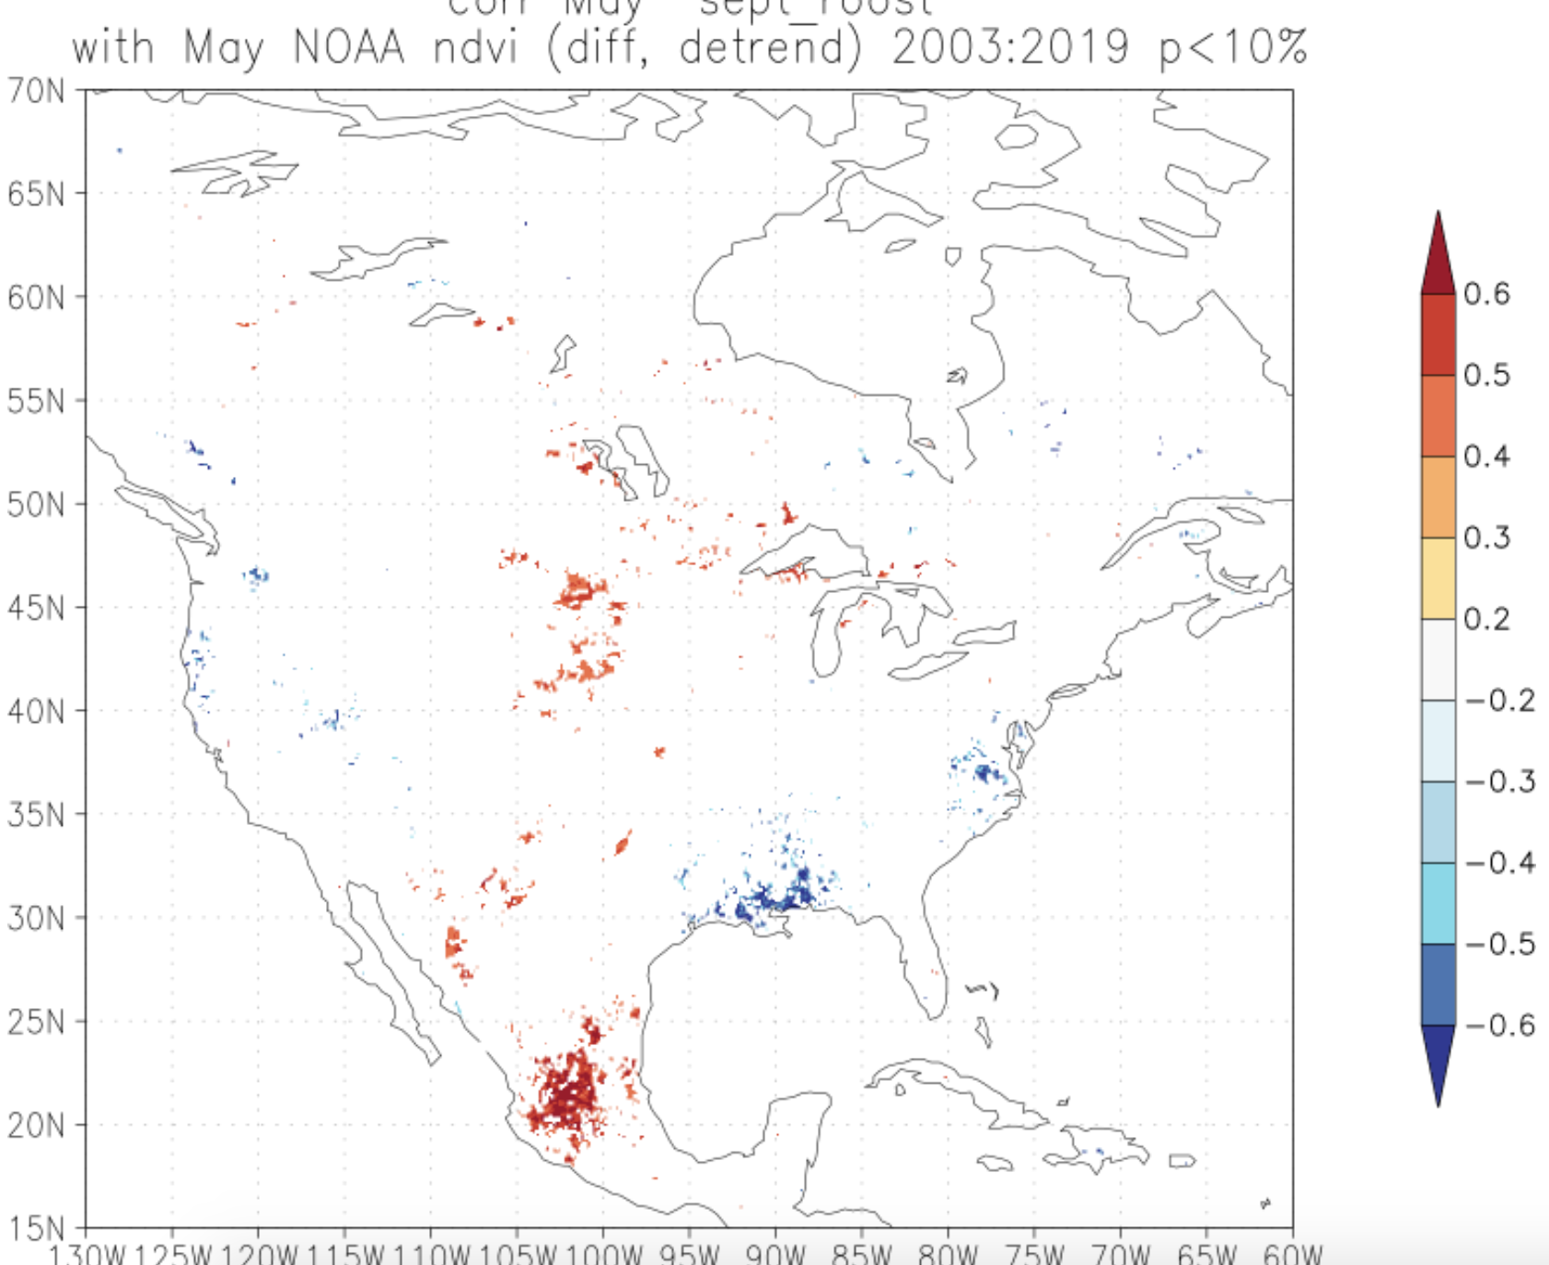
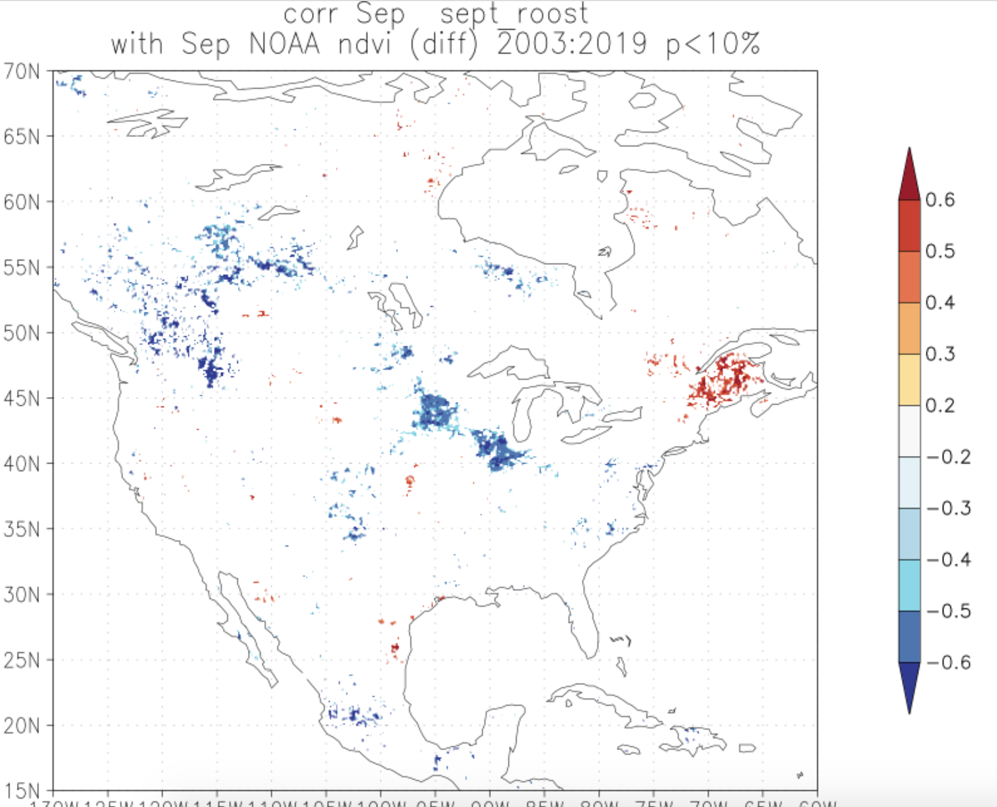
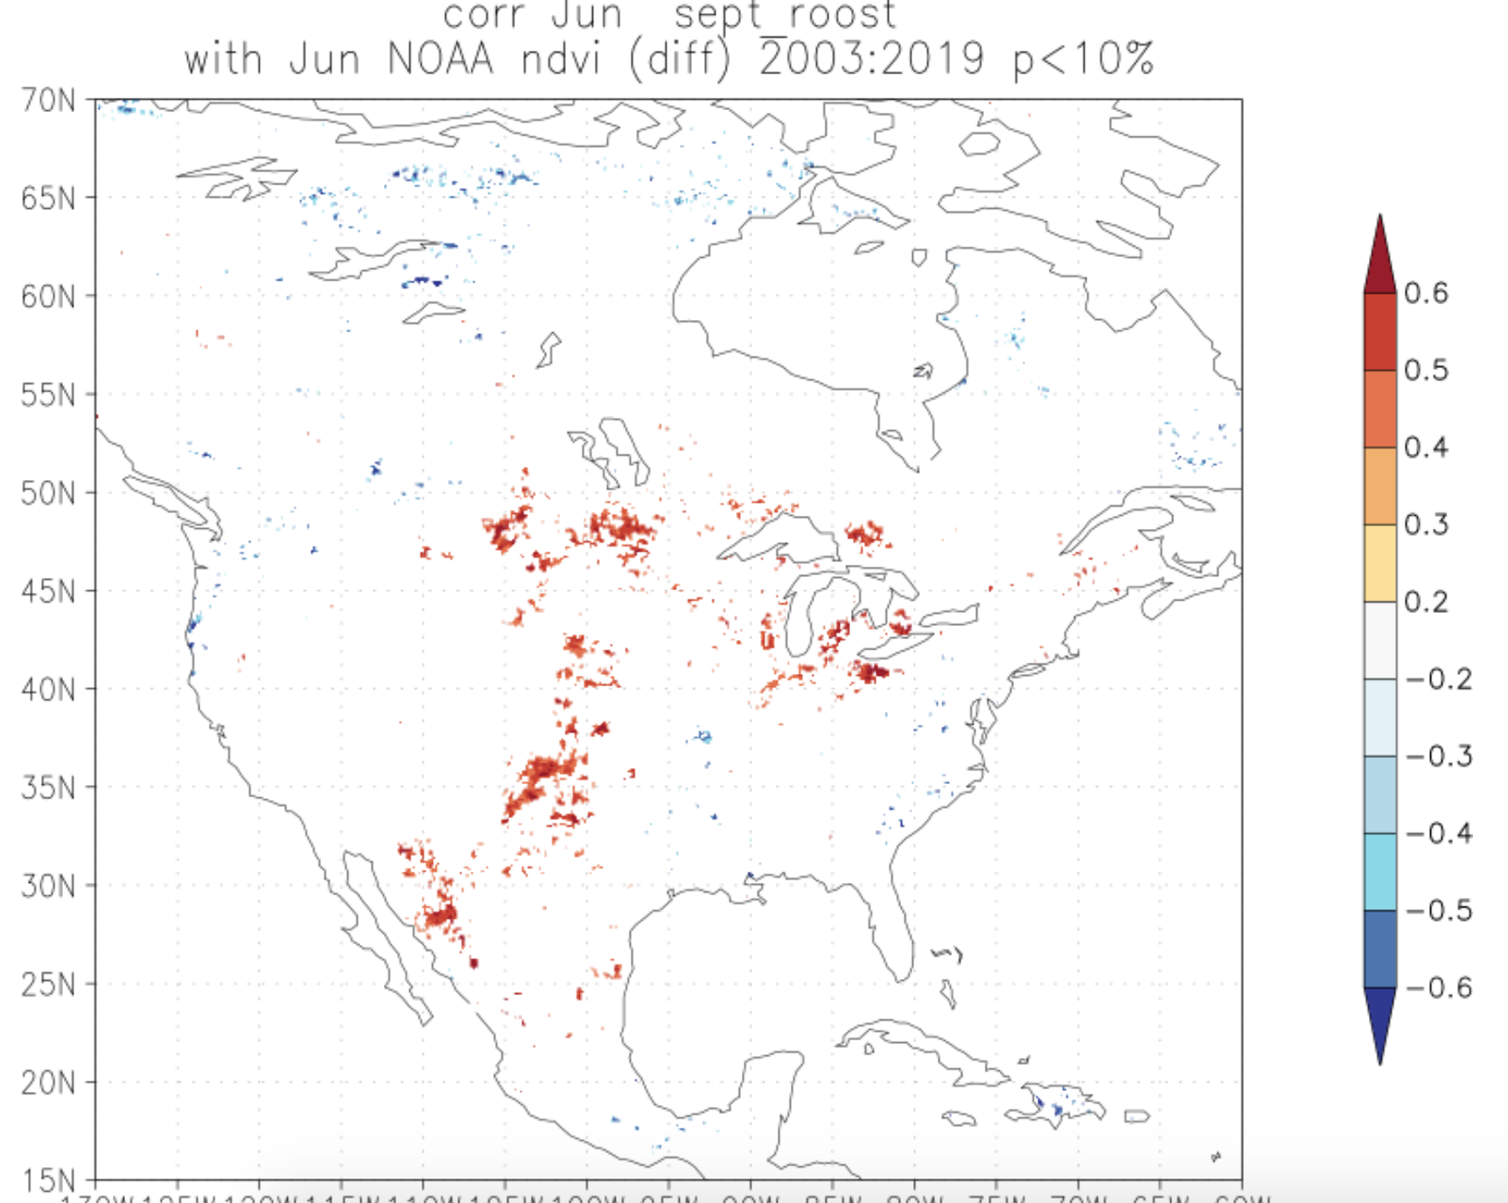
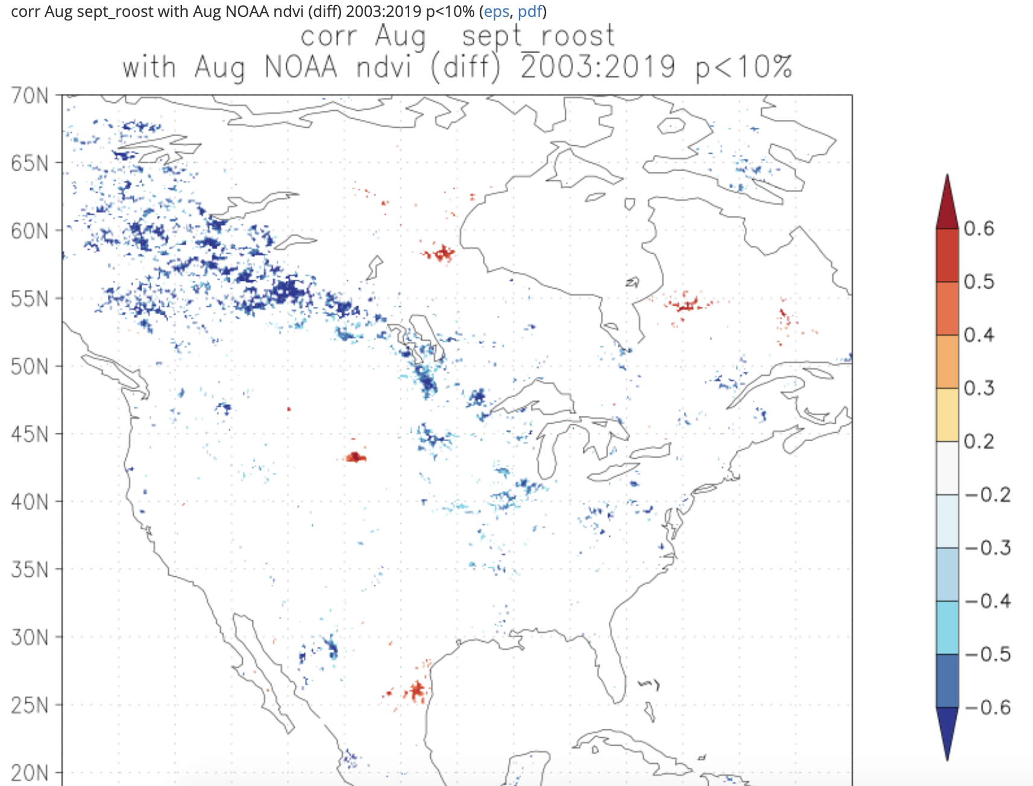
May jet stream impact on June NDVI?
Notes:
June August? August roost?
subtle changes
(supp)

Slide 16
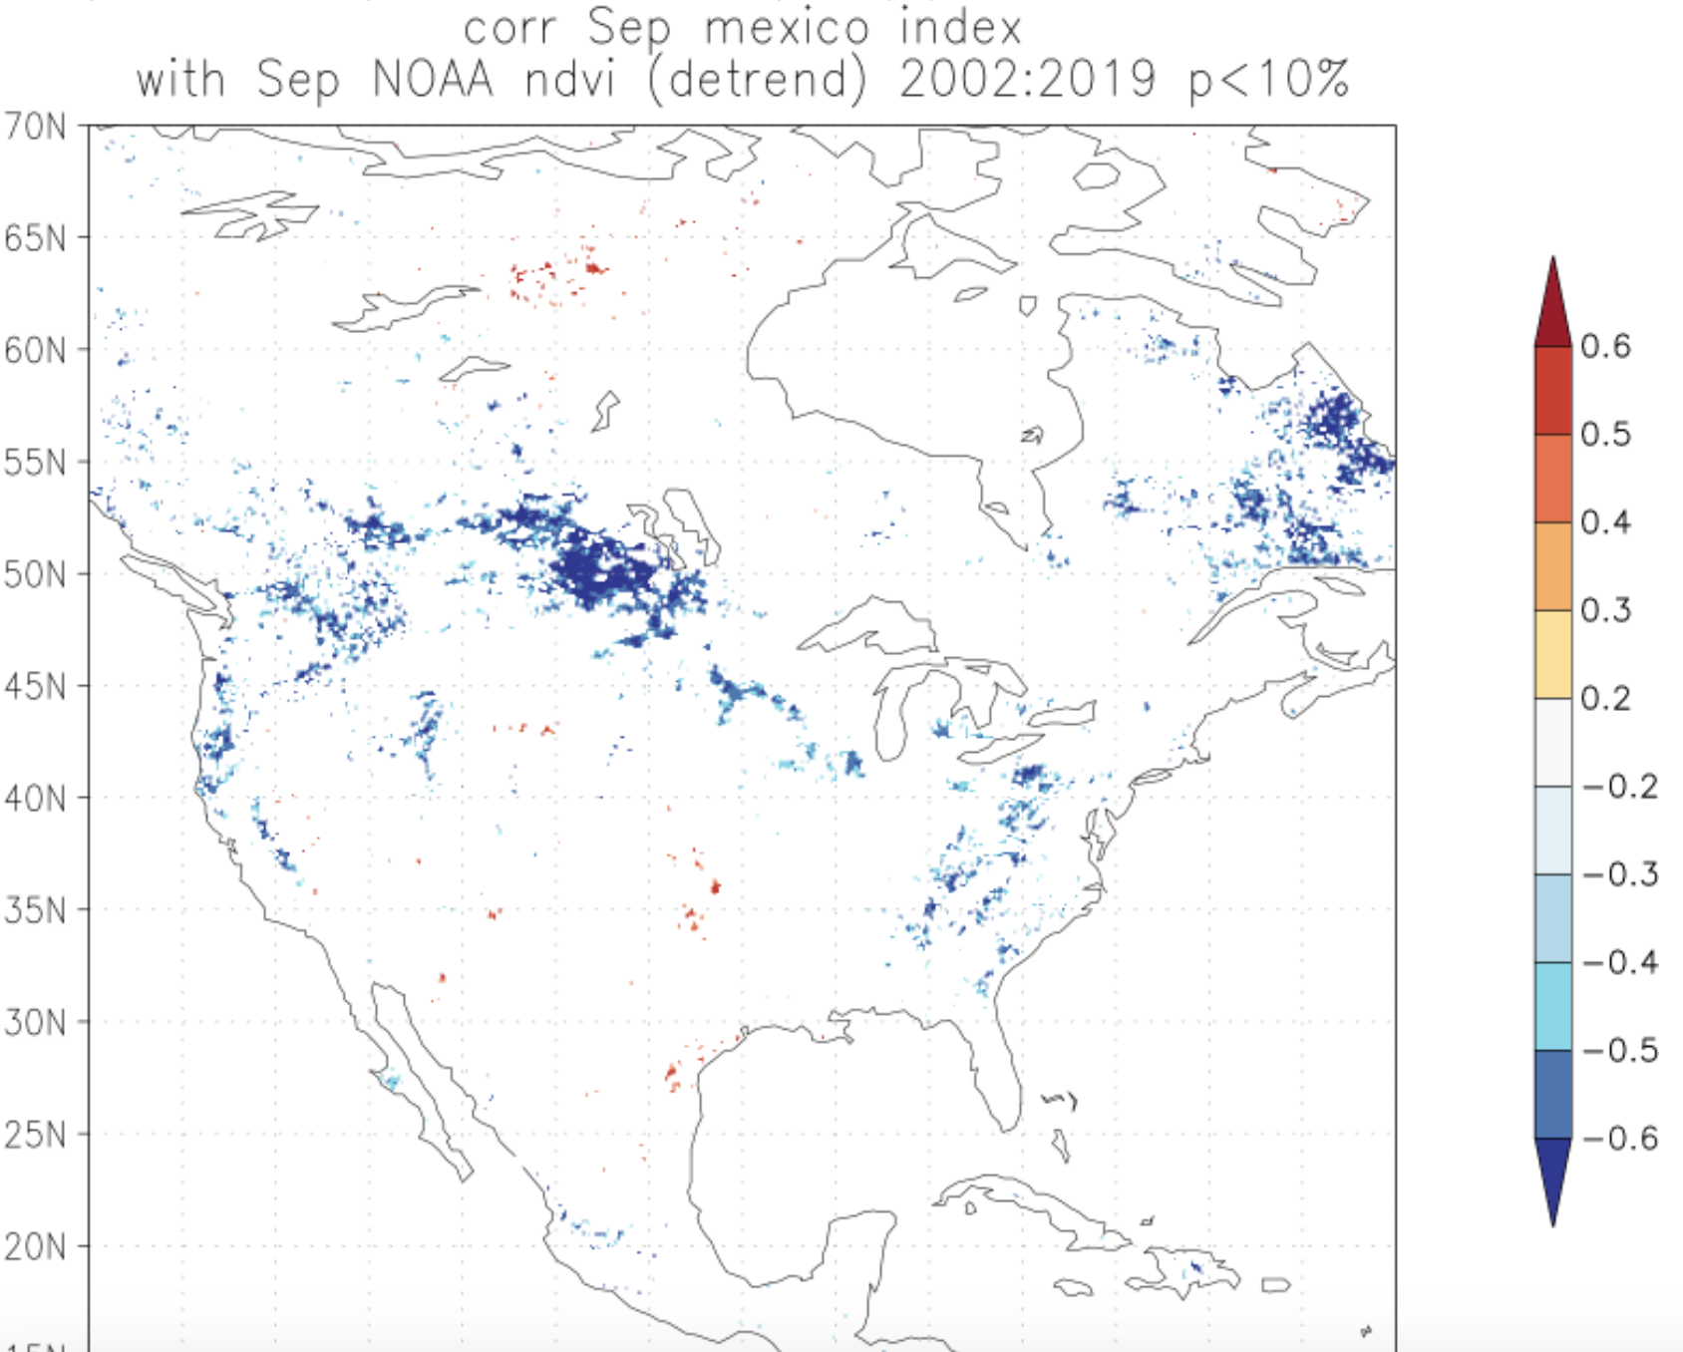
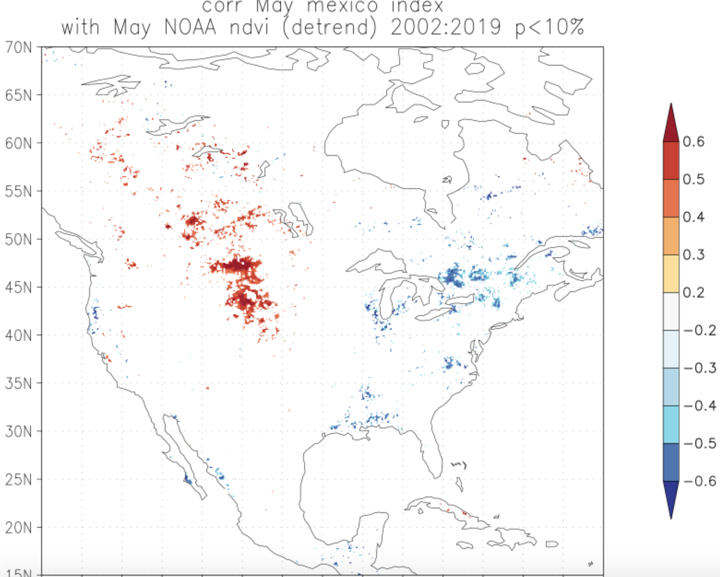
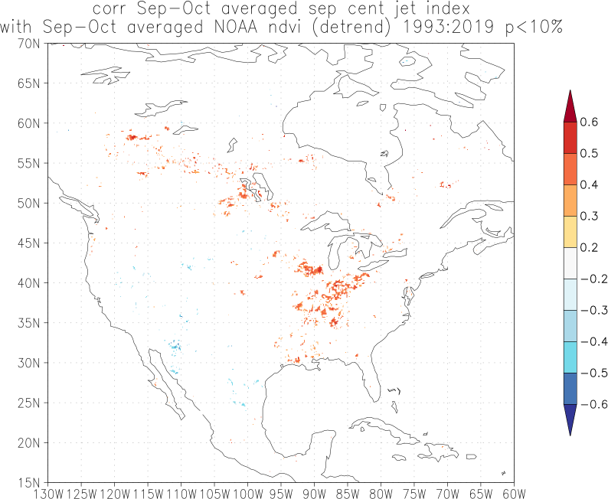
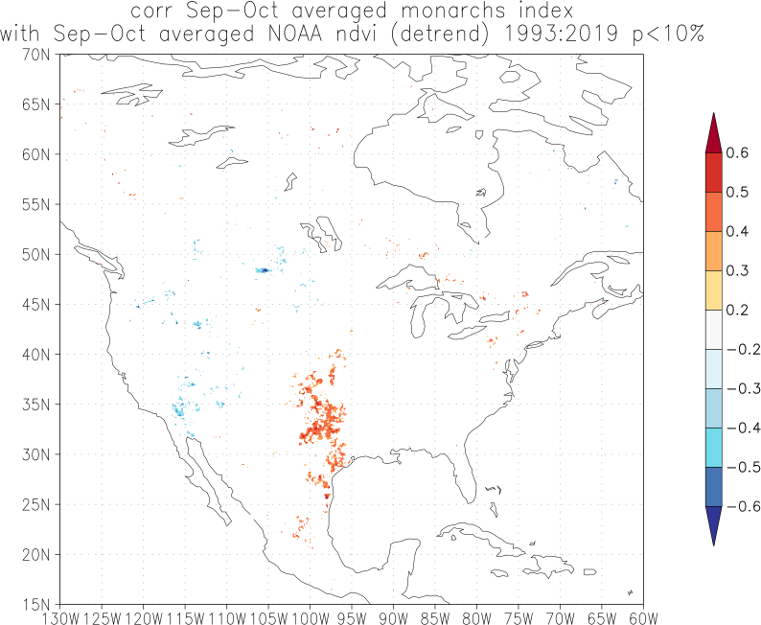
When we expanded the period to 1993-2019, the jet stream correlations shift a bit east and the winter monarch correlations condense in great plains
expand the sept jet band
Notes:
1981-2019 0.1-degree NOAA/NCEI CDR NDVI analysis home processed aggregated to September-October (would be best if I could parcel up that time sequence (mid-September to late October?)
Now re-running for September jet index from -105 to -97.5 (255-262.5) (composite of southern most averaged spetember-central jet streams
composite vs correlation?

Slide 17
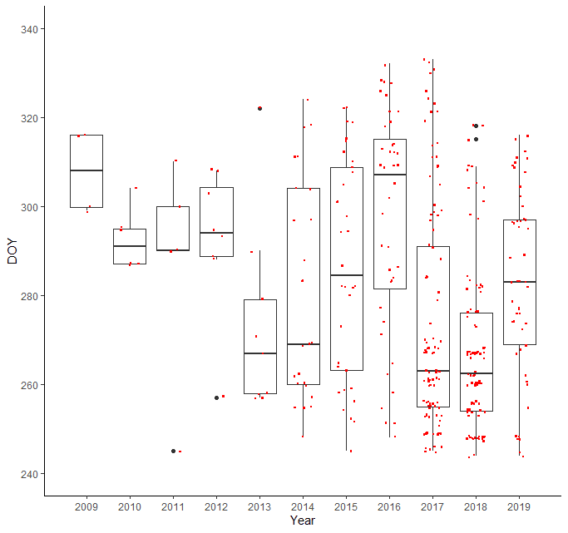
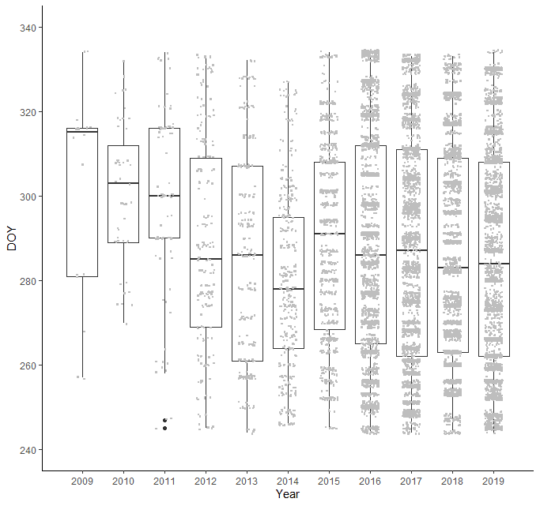
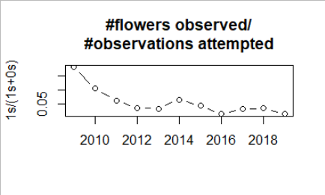
Fall migration corridor nectar availability (2016-2019)
TEXT POINT, no fig
High nectar availability (increased flowering) in both 2017 and 2018 but cool August temps in 2017

Slide 19


1’s – Yes, Flowering
0’s – No, Observed Not Flowering
phenophase_status
bounding box SC US
September-November

Slide 20
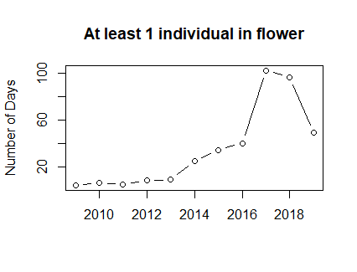


We also have some intensity values for these flowering obs- starting in 2012
Notes:
Incorporate intensity values?
Which sites were visited more than x times

Slide 21

2018??
Intensity
1) fraction of yesses to nos by region (group by how many observations of individuals by year- avoid double counting) (maybe move to Sep-Oct)
2) what proportion of individuals at a site were in flower
Play with the Sep-Nov window
3) is there some kind of flower threshold that indicates increased nectar availability for migrating monarchs?
4) what are the climatological (tmax,tmin,precip,drought) and NDVI anomalies at each site? (Sep-Nov average anomaly from 2009-2019 time period, or 2016-2019?)

Slide 22


Slide 23
Supplemental:

Slide 24
More time series- in an effort to highlight the hemispheric potential of this jet stream migration framework?
Western Monarch
TimeSeriesFallRoost (1976-2020) Durham CA from Oct-Dec
TimeSeriesOverwintering (1997-2020) Xerces data taken in California Thanksgiving count (end of November)
Data-Xerces-WesternMonarchs.xlsx
July 4 count? by NABA?
this time series could potentially be correlated with the series Anurag developed for the eastern monarch.
British Butterflies
GBIF
UK Butterfly Monitoring Scheme (UKBMS) – NBN atlas
Wider country butterfly scheme (WCBS) (2006-2018)
Notes:
Contains UK Butterfly Monitoring Scheme (UKBMS) data © copyright and database right Butterfly Conservation, the Centre for Ecology & Hydrology, British Trust for Ornithology, and the Joint Nature Conservation Committee

Slide 25
motivation for correlating Western Monarch Fall Roost and Overwintering time series
Sept Jet stream over west US correlated with minimum temperature in September
Mexico Winter Acreage correlated with minimum temperature in September
Mexico Winter Acreage correlated with September Jet Stream

Slide 26

Fall Roost out of sync
OTHER MS
No significant signal for entire period w linear detrending
2007 Durham Fall Roost much higher than Xerces Overwintering or Mexico Winter Acreage
But!: West and Mexico positively related from 2005-2017
(Xerces and Mexico r =0.48 p<0.1)
All In-Sync
western flyway ((summer?) fall, winter)
eastern (fall winter)
C) Western winter (xerces) versus eastern winter (Mexico)
correlate the jet stream for this sub-period

Slide 27




Motivation: Warm August temperatures correspond to northern jet in eastern NA; in British isles northern NAJ corresponds with warmer August temperatures and drought (Trouet et al. 2018 NCC) → more richness? and more abundance? (multiple species?)
British August Butterfly Time series
composite of higher NAO?
NAO index correlated with
Aug Sep Oct Temperature
(not as strong as looking at northern Aug jet anomalies…)
GBIF.org (5 April 2021) GBIF Occurrence Download https://doi.org/10.15468/dl.s8phbx Coordinate uncertainty in meters 0.0 - 3.0 Country or area United Kingdom of Great Britain and Northern Ireland Month August Year Between start of 1973 and end of 2021

Slide 28
Reference points
(Trouet et al. 2018 NCC https://www.nature.com/articles/s41467-017-02699-3 ) increased variability in NAJ since 1960s

Slide 29
supp supporting text
Jet stream relationship with:
plant phenology (host plant quality; nectar availability)
drought index
migratory development/ survival temperature
migratory winds (great low-level jet stream)
hurricane index – number of land falling hurricanes along the fall migration path in September-October
climate indices (e.g. summer NAO)

Slide 30


We can examine this further using august roosting observations, which are correlated with the following overwintering acreage
AUGUST sightings

Slide 31


Table of correlations between overwintering acreage and monthly jet stream position and august roosting and august jet stream position
Notes:
Add roosting correlations of other months?

Slide 32
Monarch time series’ correlations with average, minimum and maximum temperature and precipitation. Overwintering acreage correlated with climate of the previous January through December while Fall Roosting correlated with the previous January through August
(January-December)
figS5_monarch_corr_monthlytemp_prec.png
figS5_monarch_corr_monthlytemp_tmax.png
figS5_monarch_corr_monthlytemp_tmin.png
(January-August)
figS6_roost_corr_monthlytemp_prec.png
figS6_roost_corr_monthlytemp_tmax.png
figS6_ roost _corr_monthlytemp_tmin.png
figS6_ roost _corr_monthlytemp_tavg.png
ADD DROUGHT INDEX? (vegetation relevant?)
Still need to make->

Slide 33




Winter Monarch acreage correlated w monthly climate variables
Avg
Max
Min
Precip

Slide 34
Orphan slides

Slide 35



Breeding grounds: Fall Roost August sightings have interannual variability and years of higher sightings correspond with larger overwintering acreage
August

Slide 36


Breeding grounds: Fall Roost August sightings correlated with the following overwintering acreage, August Jet stream, August Average, Minimum, and Maximum temperatures
AVG
TMIN
TMAX

Slide 37

Seasonal Monarch Migration and Jet Stream
Notes:
make monthly?

Slide 38



Trend towards later end of season in this region
NDVI
AVHRR
MODIS
1994
2001
2016
Notes:
Sep 24-
October 8

Slide 39


Later end of season precedes higher monarch return and a Southern September Jet stream corresponds with later end of season
Number of pixels with significant correlations:
Winter Monarch with EOS
Number of pixels with significant correlations:
Jet stream with EOS
Notes:
499*299 =
500

Slide 40
disentangle temperature controls on monarch physiology versus milkweed phenology in August up in the breeding grounds in NE US. It seems to be a relatively data-rich region/time in the nectar connector campaign, we just hadn't worked that into our storyline yet.

Slide 42


Slide 43

Notes:
Midlatitude jet stream impact on fall monarch migration success

Slide 44




June # of observations of adult monarchs
June # of observations / # of unique locations

Slide 48


Slide 51
Extra

Slide 52

3) Monarch time series relationships

Slide 53

Anurag’s fall data details
What we’ve done before time of year, period of coverage, spatial extent
Sping South NABA correlated r2 = 0.76 with previous winter- similar to Saunders et al 2019
Spring South: 1March- 30 June
Fall South: 1 September – 30 November
Midwest and Northeast: 27 March- 3 October

Slide 54
To support hypothesis that the jet stream influences climate in August and therefore influences the overwintering acreage, we find August observations of monarchs and see whether the jet stream correlates with those observations

Slide 55

Journey North- observations throughout the year, focused on August for now
Fall Roost: Report night-time roosts. Migrating monarchs cluster together at night, typically in trees. A roost may have a handful of butterflies or far too many to count.
PEAK migration: Report peak migration events. Try to count monarchs regularly so you compare one day to the next and identify the peak. Don't hesitate to report an event as "peak" if you believe it is. We review all sightings and will contact you with questions.
[not processed yet- a lot more observations, all over US ] Adult Monarchs: Report all monarchs that you see, even if you don't know whether they are migrating. Report as long as monarchs are present, even into the winter months.

Slide 56
Data sources and summaries
JourneyNorth
August, August-1/2September, August and September; East of 105W, North of 35N; added up all occurrence events for each year (could do moving windows); didn’t look at numbers
PEAK 2000-2019 (count monarchs regularly so you compare one day to the next and identify the peak; numbers don’t appear till 2011)
Fall_Roost 2002-2019 (night-time roosts; numbers patchy until 2011)
Adults sighted January-September (don’t have yet but could process similar to GBIF, NABA,…)
GBIF (primary resources Monarch Watch and iNaturalist)
Maybe separate Monarch Watch out
Monarch observations for Jan-Dec for Globe, range from 1871-2020
Only a few entries for ‘life stage’
~350,000 observations
~/Downloads/GBIF_JulAugSep/occurance.txt year month day decimalLatitude decimalLongitude
Not yet… but moving on!
NABA: asked for counts of monarchs between May - Oct from 1990-2019 in Can, Mex, and US
Katy requested on 9/30, waiting on a quote for cost
Inamine et al.: For each date, we calculated an equally weighted average of all the counts in the region falling in a seven-day window, centered around that date. 105 meridian
Xerces (email contact)

Slide 57


Notes:
Correlation with each other- stronger take average and correlate w overwintering acreage!
Detrend Fall Roost

Slide 58
August Jet correlated with August JN PEAK and ROOST
Winter Monarch
Notes:
Is Peak and Roost data clustered in the 80 and 73-68 range? (I think so!)
Average of both
Constraining latitude* longitude bounds next step

Slide 59






JN Peak8 and Roost8 correlations with climate
ROOST
AVG
Winter
Acreage
TMIN
PEAK
AUG
AUG
TMIN
Winter
Acreage
TMAX
AVG
Constrain bounds
95W 75W
50N 35N
TMIN

Slide 60
Next Steps
Update scripts for 2019 climate
Work to get stronger correlations between Summer estimate and Overwintering Acreage:
longitude bounds
detrending (especially for Fall Roosts)
Average Peak and Roost time series/ check between monthly/ different time scales
Average August and September Jet stream*
held off on this- seems important to keep as fine a time scale as possible for monarchs?
Other methods to develop indices: Moving windows; incorporating counts (not viable for JN); other months?
GBIF (not much metadata on life stage) and Journey North Adult Monarch sighting
Plant phenology story? Extending growing season in September

Slide 61

Detrended, Longitude/Latitude Bounds modified
Winter_acreage

Slide 62






DETRENDED: August Peak, Roost, and PeakRoost Average correlations with climate
where are obs:
roost data more spatially
constrained? (map points)
Just change axes for same jet map +
add box for where grabbed peak roost from
Chip taylor MonarchWatch GBIF in Canada?
ROOST
100W 70W
55N 35N
AVG
Winter
Acreage
TMIN
PEAK
AVG
TMAX
TMIN
Winter
Acreage
TMAX
PEAKROOST
TMIN
TMAX
AVG
TMIN
TMAX

Slide 63






Other months to check out bc overwintering monarch acreage correlate w climate e.g March constrained obs by those occurring in March in South/ Texas
Maybe 1st monarch on Journey North 2000-2020
TMIN
TMAX
TAVG

Slide 64

Would also be good to get descriptor ranges of Numbers for the ROOST obs – getting back to our ‘we’re seeing more monarchs ergo more representative’ argument.

Slide 65


rcorr(JN_first_3[3:20],JN_ROOST_8)#r = 0.58 p = 0.01
rcorr(JN_first_3,meanlat)#r = 0.49 p = 0.03
linear models combining various variables don’t help

Slide 66


Looked into June Max, Min, Mean correlated (insignificant, and small variability past 5 yrs)
low variability the past 6 years

Slide 67


Slide 68
Every year, monarch butterflies set off on a multi-generational, continental migration as they follow the wave of milkweed blooms from Mexico to Canada and back again. This annual migration matches the seasonal redistribution of solar energy and the corresponding latitudinal movement of the northern hemisphere jet stream (NHJ), responsible for regional patterns of climate at the surface. Surface climate, and especially temperature thresholds, directly correspond to insect physiology and fitness, and (sometimes combined with precipitation delivery) can also influence host and nectar plant phenology and availability along the migration path.
Here, we investigate how much variability in monarch migration is linked to jet stream-influenced climate at critical periods in the migration. We leverage and integrate multiple datasets, including: previously published seasonal and geographically-referenced monarch observations; monthly latitudinal positions of the NHJ resolved at 2.5 degree longitudinal windows; monthly climate fields; satellite NDVI-derived products of the start, peak, end and length of season; and the bloom time of 53 milkweed host plant and nectar plant species from the US National Phenology Network.
We find significant correlations between monthly NHJ anomalies and monarch estimates throughout the year that coincide with changes in climate over breeding grounds and plant phenology along the migration path. In particular, northern anomalies from the climatological mean NHJ position reflect warmer August temperatures in northeastern US breeding grounds and lead to higher overwintering acreage in Mexico that year. In late September to early October, southern NHJ anomalies over the Great Plains corresponded with more precipitation, cooler temperatures, higher NDVI (an indicator of nectar availability) and changes to the growing season- all contributing to more favorable resource availability and conditions for returning monarchs passing through in October and November. By characterizing the mechanisms behind jet stream influence on monarch migration, we highlight the importance of regional climate connectivity to a long distance migrating organism in contextualizing the effectiveness of conservation efforts focused on host plant maintenance in the summer breeding grounds.

